Slide 1

Breaking the Formal Verification Bottleneck
Menachem Rappaport, Ariel Ansbacher, Elchanan Rappaport - Veriest Solutions

Slide 2
Standard design – with parameters
Any parameter value change requires a new run.
All legal input signal values are tested in a single run.
Parameters
Design
output signals
Input signals

Slide 3
Signal design
Design
All legal input signal values are tested in a single run.
Only
Input signals
output signals

Slide 4
General Idea – P2S (Parameters to Signals)
Parameters
Design
convert parameters to signals
Design
Only
Input signals
output signals
output signals
Input signals
Verify the blocks are functionally equivalent
This will be used for syntheses
This will be used for verification

Slide 5
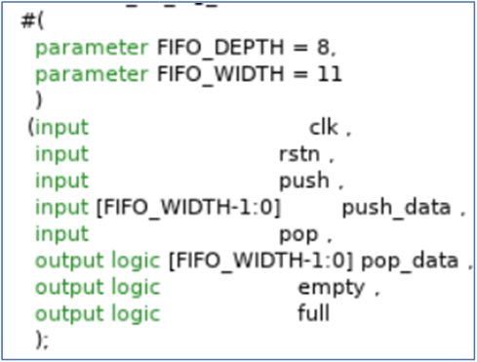
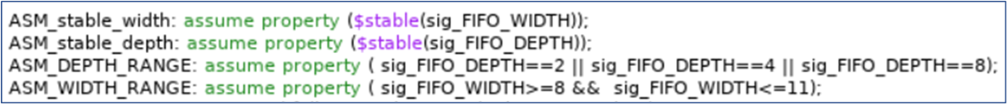
Interface Changes
We modified the DUT interface so that stable input signals replace the parameters.

Slide 6
Compiler flow
We used an open-source AST and code generator.
We have written our own script to modify the AST.
Parameter
code
Parameter
AST
Signal
AST
Signal
code
P2S script
code generator
AST generator

Slide 7
LEC test
LEC proves that both blocks are functionally equivalent.
The runtime is short and insignificant.

Slide 8
Runtime results
We did our research on 3 different tools and 4 different blocks
Design example | Number of Permutations | Tool 1 Speedup | Tool 2 Speedup | Tool 3 Speedup
Advanced FIFO | 96 | 258% | 400% | 644%
ALU | 24 | 675% | 511% | 346%
APB XBAR | 16 | 357% | 334% | -
AXI bridge | 27 | 304% | 147% | 184%

Slide 9
Conclusions
We tested 4 different designs with 3 different tools.
For almost all designs, the runtime improved.
For most designs, performance improvements exceeded 300%.

Slide 10

Questions?
Thank you
You can view an example at: https://github.com/MenachemRapp/p2s_fifo_example

