Slide 1
An Early Stage Coverage Measurement Methodology For Common Features of System-On-Chip Verification, Using Design Metadata And Large Language Models
Myeongwhan Hyun
Samsung Electronics Co., Ltd.

Slide 2
Introduction: SoC Design Verification (SoC DV)
Verifies Integration of IPs in SoC
Ensures the functional correctness, reliability, and performance
Methods:
Dynamic simulation - Universal Verification Methodology (UVM)
Static simulation - Clock Domain Crossing (CDC), Reset Domain Crossing (RDC)
Why is SoC DV important?
Increasing complexity of modern SoC architectures.
Various applications (e.g., Mobile, Data Center, Automotive, and AI)
Prevents costly errors and delays, such as ASIC respins.

Slide 3
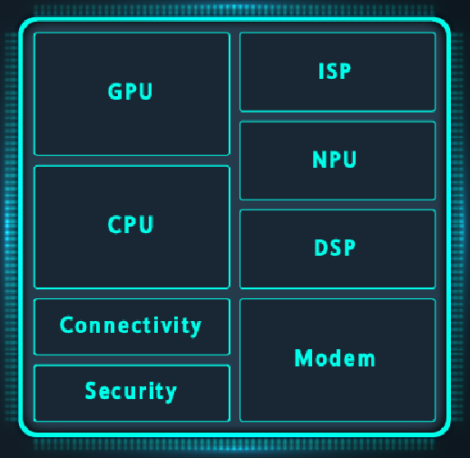
Introduction: Common Tasks
Dynamic simulations remain essential to verify common features and IPs
Tightly integrated system-level behavior of the SoC
What are Common Tasks (CTs)?
Defined to verify common features and IPs across multiple blocks in SoC
Common features: e.g., clock, reset, security and power
Common IPs : e.g., CMU, PMU and MMU
Over 40% of total UVM-based verification.
CTs are released by each DV specialist.
Providing a standardized function scenarios in UVM and a guide.

Slide 4
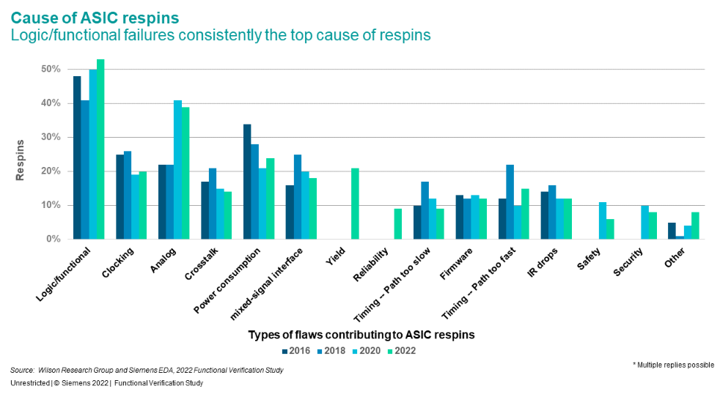
Motivation: Challenges (1)
Late-stage Coverage
Conventional schemes applied only after simulations
Limits coverage to latest stages of verification
Risks undetected logic/functional flaws, the leading cause of ASIC respins.

Slide 5
Motivation: Challenges (2)
Omission Risks
CT omission -> Late-stage flaws & high resource costs.
Manual verification plan review increases TAT
High Complexity of Implementing Coverage in SoC
Numerous and diverse SoC function scenarios
Coverage limitations: Certain SoC features are not effectively measurable

Slide 6
Objectives
Common Task Coverage (CTC) Methodology
Measure coverage of CTs
Enable early-stage quantitative coverage measurement for verification plan and UVM TB
Reduce TAT & enhance DV quality by identifying coverage gaps early.
Design specification
review
Verification plan
development & review
Simulation-based verification
(Implemented by UVM)
Coverage
closure
Specifications to be reviewed
* HDD
** SOR
Scenarios
Features to be verified
Priorities
Test bench set up
Test & sequence development
Simulations
Conventional coverage
▪ Function coverage
▪ Code coverage
Verification plan coverage
UVM TB coverage by LLM
Common Task Coverage Methodology
* HDD: Hardware Description Document
** SOR: Statement Of Request

Slide 7
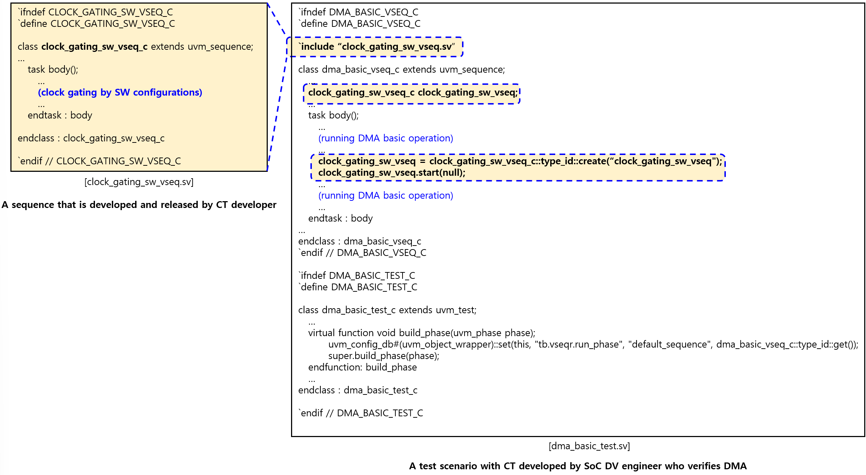
CTs in SoC DV (1)
Defined to help verifying common features and IPs in UVM TB
Direct function scenarios with UVM sequences and checkers
Fully applying constraint random verification proves challenging at the SoC level
[Guide for ‘SW clock gating’ common task]
Notice :
(Files to be updated, specific notice for designs)
2. Purpose
Check if SW can turn on and off the clock for the IP
Check if the proper frequency of IP can be provided for the IP
Check if the IP works after the clock gating and un-gating
3. Test scope
All IPs in each block
4. Design overview
(Basic protocols for CMU, how to control the clocks for an IP)
5. Test guide
(The sequences & checkers to be called)
6. Example
(Example codes for the CT)

Slide 8
CTs in SoC DV (2)
Contents included in CT guides
Sections | Contents
Purpose | Defines the objective or goal of the CT in the context of DV
Scope | Specifies the range of IPs or features to be verified using the CT
Design Overview | Provides essential design details necessary to understand the context and application of the CT
Test Implementation | Outlines a detailed guide and step-by-step instructions for implementing the CT in user-defined sequences
Example | Includes ample UVM code demonstrating the implementation of the CT

Slide 9
CTs in SoC DV (3)
Typical examples of CTs in SoC DV
Feature | Sub-feature | Purpose
Register | Read and Write (R/W) | Verify whether registers can be written and read by masters
Security | Register protection | Verify whether registers can be protected by the security controls
 | Memory protection | Verify whether memories can be protected by the security controls
Clock | Clock gating controlled by Software (SW) | Verify whether an IP can operate after gating the clock controlled by SW
 | Clock gating controlled by Hardware (HW) | Verify whether an IP can operate after gating the clock controlled by HW
 | Dynamic Voltage and Frequency Scaling (DVFS) | Verify whether an IP can operate during DVFS
Power | Power gating controlled by SW | Verify whether an IP can operate after gating the power controlled by SW
 | Power gating controlled by HW | Verify whether an IP can operate after gating the power controlled by HW
 | SoC power scenarios | Verify whether an IP can operate after the SoC power scenarios
Core | Memory Management Unit (MMU) | Verify whether an IP can generate a traffic and the address can be translated by MMU or the traffic can be protected by MMU
Reset | Watch Dong Timer (WDT) reset | Verify whether an IP can operate after WDT reset is asserted

Slide 10
Overview of the CTC Methodology (1)
Three-step coverage measurement approach
1. Define Coverage Bins based on metadata from design specifications
2. Establish Coverage bins in verification plan
3. Evaluate the implementation of CT in UVM TB using Large Language Models (LLMs)
Integration with in-house Dashboard
Enables real-time monitoring of CTC status
Supports comprehensive coverage reviews for coverage closure.

Slide 11
Overview of the CTC Methodology (2)
Overall architecture of CTC methodology
Core IPs: IPs which are not covered by common IPs
Main sources
Coverage bin
Coverage dashboard
Register map
IP dataset
Block | Feature | Sub-feature | Core IP | Verification plan hit | TB hit
Block A | Reset | WDT** HW*** reset | Master A | Hit | Miss
Block A | Reset | SW reset | Master A | Hit | Hit
… | … | … | … | … | …
Block C | Reset | WDT HW reset | DMA A | Miss | Miss
… | … | … | … | … | …
Block C | Clock | Clock gating | DMA B | Hit | Hit
Block C | Power | Power gating | DMA C | Miss | Hit
.. | … | … | … | … | …
Network on Chip specification
Common IP
Power specification
CTC bin generator
IP-XACT
Verification plan
Dashboard
API*
UVM TB
Fine-tuned LLM
CT guide
*API : Application Programming Interface
**WDT : Watch Dog Timer
*** HW : Hardware
: Design specification

Slide 12
Define Coverage Bins (1)
Foundational step to implement coverage for CTs.
Use metadata from design specifications to validate designs
Metadata sources
Design specifications | Details | Contents required for metadata
Register map | Details for overall registers in each block Include IP names and their base addresses | IP names for each block
Network on Chip (NoC) specification | Details for overall NoC Include master and their information for interfaces | Master names for each block
Power specification | Details for power domains with their specifications | Power features for each block
IPXACT | Details of SoC implementations Include IP names and their hierarchies | Interfaces for each block

Slide 13
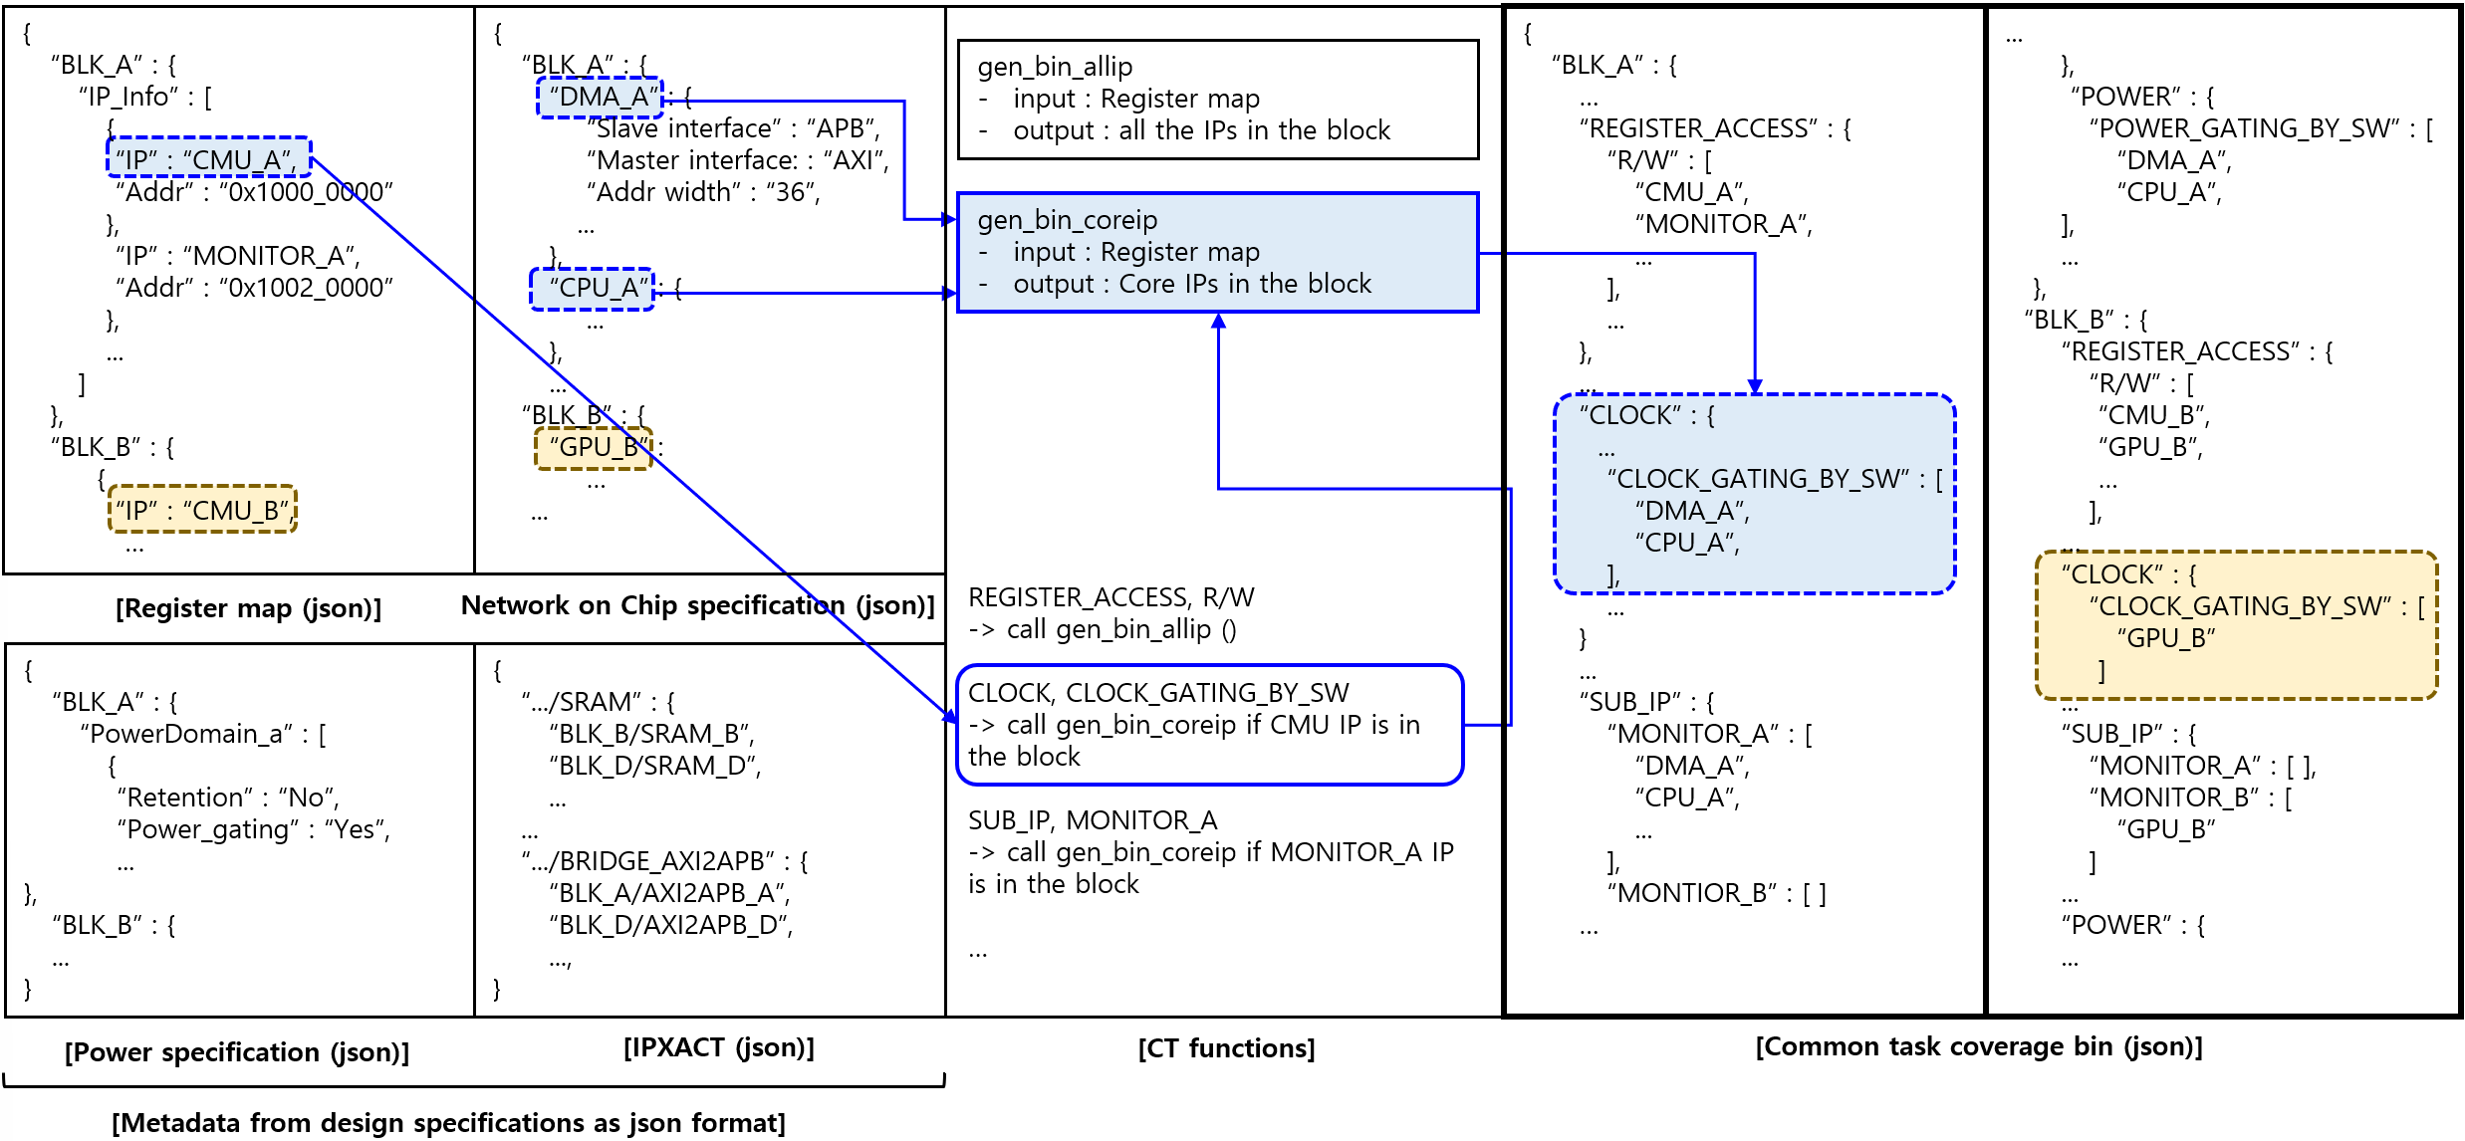
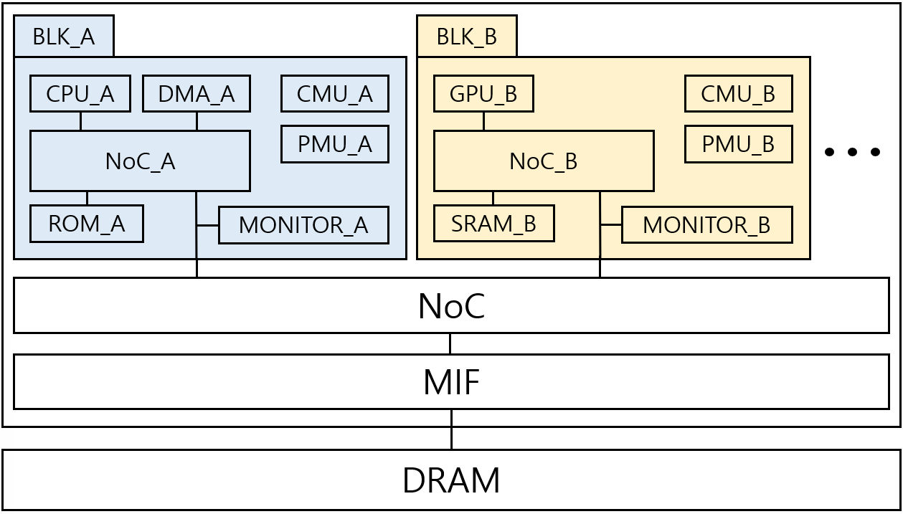
Define Coverage Bins (2)
Process of generating CTC bins in an SoC example

Slide 14
Verification Plan Coverage
Coverage measurement system for the verification plan
To prevent overlooked tests scenarios during the verification planning phase.
Our in-house dashboard API enables this methodology
Targets to be parsed from verification plan
Data from coverage bin
Test ID | Feature | Sub-feature | IP | Test Run command
A001 | REGISTER_ACCESS | R/W | CMU_A | (test_cmd_a001)
A002 | REGISTER_ACCESS | R/W | MONITOR_A | (test_cmd_a002)
… | … | … | … | …
A080 | REGISTER_ACCESS | USER | CMU_A | (test_cmd_a080)
… | … | … | … | …
A010 | CLOCK | CLOCK_GATING_BY_SW | DMA_A | (test_cmd_a010)
.. | … | … | … | …
A050 | POWER | POWER_GATING_BY_SW | CPU_A | (test_cmd_a050)
… | … | … | … | …
Feature | Sub-feature | IP | Test ID | Status | Notes
REGISTER_ACCESS | R/W | CMU_A | A001 | COVERED
REGISTER_ACCESS | R/W | MONITOR_A | A002 | COVERED
… | … | … | … | …
CLOCK | CLOCK_GATING_BY_SW | DMA_A | A010 | COVERED
CLOCK | CLOCK_GATING_BY_SW | CPU_A | - | NOT_COVERED
… | … | … | … | …
POWER | POWER_GATING_BY_SW | DMA_A | - | NOT_COVERED
POWER | POWER_GATING_BY_SW | CPU_A | A050 | COVERED
… | … | … | … | …
Dashboard API
[ Verification plan ]
[ Coverage dashboard for verification plan ]

Slide 15
UVM TB Coverage with LLM (1)
Employed an LLM to evaluate the UVM TB implementation coverage for CTs.
Inconsistency in implementation
Manual code review challenges
Automatic benefits.
Developed a local LLM model
To protect sensitive and confidential data
Avoid dependence on external networked models for security
Chose ‘DeepSeek-Coder-V2':
High benchmark scores
Specific training in verilog and system verilog

Slide 16
UVM TB Coverage with LLM (2)
Trained on project-specific data to adapt if for SoC DV, including:
Verification plan
RTL and UVM TB
Hardware Description Documents (HDD)
Employed 'Retrieval-Augmented Generation' (RAG)
To allow the model to reference in-house data for a query
Addresses LLM limitations by retrieving relevant external information
Filling knowledge gaps and improving contextual accuracy
Integrated ‘Chain of Thought’ (CoT) into RAG
Requires the model to ask step-by-step explanations
Improved response accuracy

Slide 17
Architecture for UVM TB Coverage with LLM (1)
Step 1. Fine-tuned DeepSeek-coder-V2
Trained on RTL, UVM TB, and verification plans
Enhanced domain-specific understanding and in-house data comprehension
FAISS
RAG-Enhanced Prompt
vector DB
### Review Items
## test run command:
run-{test name from verification plan}
## test file:
{test_code}
## sequence file:
{sequence_code}
Please verify whether the command and test files are structured according to the provided guidelines.
Step-by-Step Process:
1) Consider the item incorrect if any part does not match or is missing according to the guide
2) Check if the command exactly follows the rules and guidelines provided in the guide
3) Check if the code that the guide requires to be included is present in the test file.
4) Internally generate explanations for each item to be checked in the guide,
and based on these, provide a final result of either 'Yes' or 'No'
### Guidelines:
{ct_guide}
Sequence code
Fine-tuned LLM
CT test codes and run commands
(derived from uvm_sequence)
(Pairs of test code & sequence code)
Test code
(derived from uvm_test)
vector DB
CoT-based instructions
Fine-tuned LLM
Verification plan
(Pairs of verification plan & test code)
CT guide
Fine-tuned LLM
vector
Fine-tuned LLM
‘Covered’ or
‘Not covered’
CT guide

Slide 18
Architecture for UVM TB Coverage with LLM (2)
Step 2. Generated vector DB for verification plans and test codes
Stored verification plan and test codes in FAISS (Facebook AI Similarity Search)
For efficient similarity search and retrieval
FAISS
RAG-Enhanced Prompt
vector DB
### Review Items
## test run command:
run-{test name from verification plan}
## test file:
{test_code}
## sequence file:
{sequence_code}
Please verify whether the command and test files are structured according to the provided guidelines.
Step-by-Step Process:
1) Consider the item incorrect if any part does not match or is missing according to the guide
2) Check if the command exactly follows the rules and guidelines provided in the guide
3) Check if the code that the guide requires to be included is present in the test file.
4) Internally generate explanations for each item to be checked in the guide,
and based on these, provide a final result of either 'Yes' or 'No'
### Guidelines:
{ct_guide}
Sequence code
Fine-tuned LLM
CT test codes and run commands
(derived from uvm_sequence)
(Pairs of test code & sequence code)
Test code
(derived from uvm_test)
vector DB
CoT-based instructions
Fine-tuned LLM
Verification plan
(Pairs of verification plan & test code)
CT guide
Fine-tuned LLM
vector
Fine-tuned LLM
‘Covered’ or
‘Not covered’
CT guide

Slide 19
Architecture for UVM TB Coverage with LLM (3)
Step 3. Generated vector DB for UVM test codes and sequences
Enhanced similarity assessment diversity, improving vector DB precision.
FAISS
RAG-Enhanced Prompt
vector DB
### Review Items
## test run command:
run-{test name from verification plan}
## test file:
{test_code}
## sequence file:
{sequence_code}
Please verify whether the command and test files are structured according to the provided guidelines.
Step-by-Step Process:
1) Consider the item incorrect if any part does not match or is missing according to the guide
2) Check if the command exactly follows the rules and guidelines provided in the guide
3) Check if the code that the guide requires to be included is present in the test file.
4) Internally generate explanations for each item to be checked in the guide,
and based on these, provide a final result of either 'Yes' or 'No'
### Guidelines:
{ct_guide}
Sequence code
Fine-tuned LLM
CT test codes and run commands
(derived from uvm_sequence)
(Pairs of test code & sequence code)
Test code
(derived from uvm_test)
vector DB
CoT-based instructions
Fine-tuned LLM
Verification plan
(Pairs of verification plan & test code)
CT guide
Fine-tuned LLM
vector
Fine-tuned LLM
‘Covered’ or
‘Not covered’
CT guide

Slide 20
Architecture for UVM TB Coverage with LLM (4)
Step 4. Prepared prompt inputs using FAISS for RAG
Combined vector DBs from step 2 and 3 with a verification plan DB
Provided comprehensive contextual data to enrich prompts with in-house data.
FAISS
RAG-Enhanced Prompt
vector DB
### Review Items
## test run command:
run-{test name from verification plan}
## test file:
{test_code}
## sequence file:
{sequence_code}
Please verify whether the command and test files are structured according to the provided guidelines.
Step-by-Step Process:
1) Consider the item incorrect if any part does not match or is missing according to the guide
2) Check if the command exactly follows the rules and guidelines provided in the guide
3) Check if the code that the guide requires to be included is present in the test file.
4) Internally generate explanations for each item to be checked in the guide,
and based on these, provide a final result of either 'Yes' or 'No'
### Guidelines:
{ct_guide}
Sequence code
Fine-tuned LLM
CT test codes and run commands
(derived from uvm_sequence)
(Pairs of test code & sequence code)
Test code
(derived from uvm_test)
vector DB
CoT-based instructions
Fine-tuned LLM
Verification plan
(Pairs of verification plan & test code)
CT guide
Fine-tuned LLM
vector
Fine-tuned LLM
‘Covered’ or
‘Not covered’
CT guide

Slide 21
Architecture for UVM TB Coverage with LLM (5)
Step 5. Implemented RAG-enhanced prompt for LLM
Developed structured prompt: test commands, UVM TB, and CT guides.
Integrated CoT to improve response accuracy
FAISS
RAG-Enhanced Prompt
vector DB
### Review Items
## test run command:
run-{test name from verification plan}
## test file:
{test_code}
## sequence file:
{sequence_code}
Please verify whether the command and test files are structured according to the provided guidelines.
Step-by-Step Process:
1) Consider the item incorrect if any part does not match or is missing according to the guide
2) Check if the command exactly follows the rules and guidelines provided in the guide
3) Check if the code that the guide requires to be included is present in the test file.
4) Internally generate explanations for each item to be checked in the guide,
and based on these, provide a final result of either 'Yes' or 'No'
### Guidelines:
{ct_guide}
Sequence code
Fine-tuned LLM
CT test codes and run commands
(derived from uvm_sequence)
(Pairs of test code & sequence code)
Test code
(derived from uvm_test)
vector DB
CoT-based instructions
Fine-tuned LLM
Verification plan
(Pairs of verification plan & test code)
CT guide
Fine-tuned LLM
vector
Fine-tuned LLM
‘Covered’ or
‘Not covered’
CT guide

Slide 22
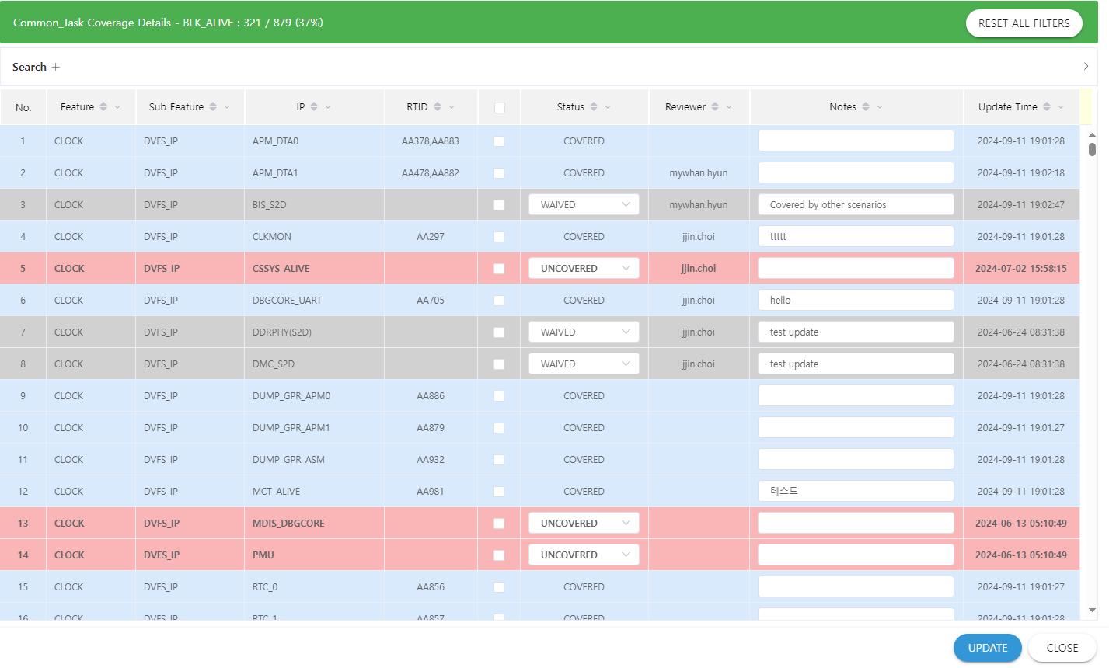
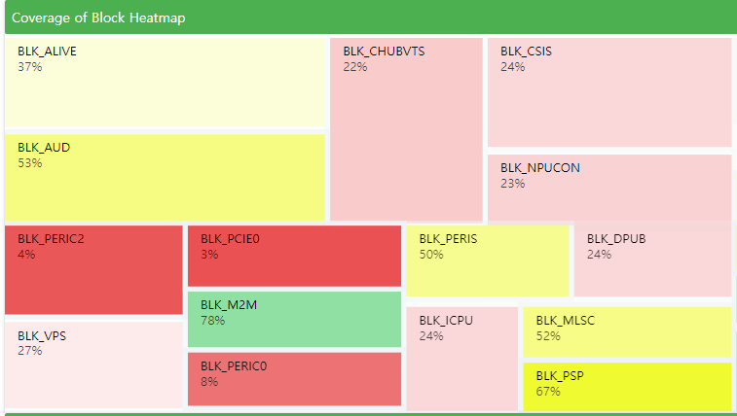
In-House Coverage Dashboard for Coverage Closure
Synchronize CTC bins and store data periodically
Provides coverage visualization tools, status reports, and waiver management.
Block A
Block A
Block E
Block I
IP A
Block B
IP B
Reviewer A
Block J
IP C
Reviewer B
IP D
Reviewer B
IP E
Reviewer A
Block C
Block F
Block K
Block M
IP F
Reviewer C
IP G
Reviewer C
IP H
Reviewer C
Block G
IP I
Block D
Block L
Block N
IP J
Block H
IP K
Block O
IP L
IP M

Slide 23
Result: Verification Plan Coverage
CTC analysis highlights key gap results across different SoC project sizes.
Oversight is the dominant cause of gaps
New IPs/feature contribute more gaps in larger SoCs.
 | CT used (#) | Total (#) | Coverage gaps
 |  |  | Total (#) | Introduction of new IPs or Feature (#) | Modifications to the design (3) | Omission by oversight (#)
Project A | 39 | 10641 | 293 | 117 | 5 | 171
Project B | 35 | 4325 | 216 | 4 | 4 | 208

Slide 24
Result: UVM TB Coverage (1)
Fine-tuned LLM evaluation with RAG-based prompt
An example for comparing two test items for a specific CT
‘Yes’ (Covered) vs ‘No’ (Not Covered)
Demonstrates LLM’s comprehension of system Verilog and proprietary data
Leverages RAG and CoT techniques to improve accuracy with step-by-step decision-making

Slide 25
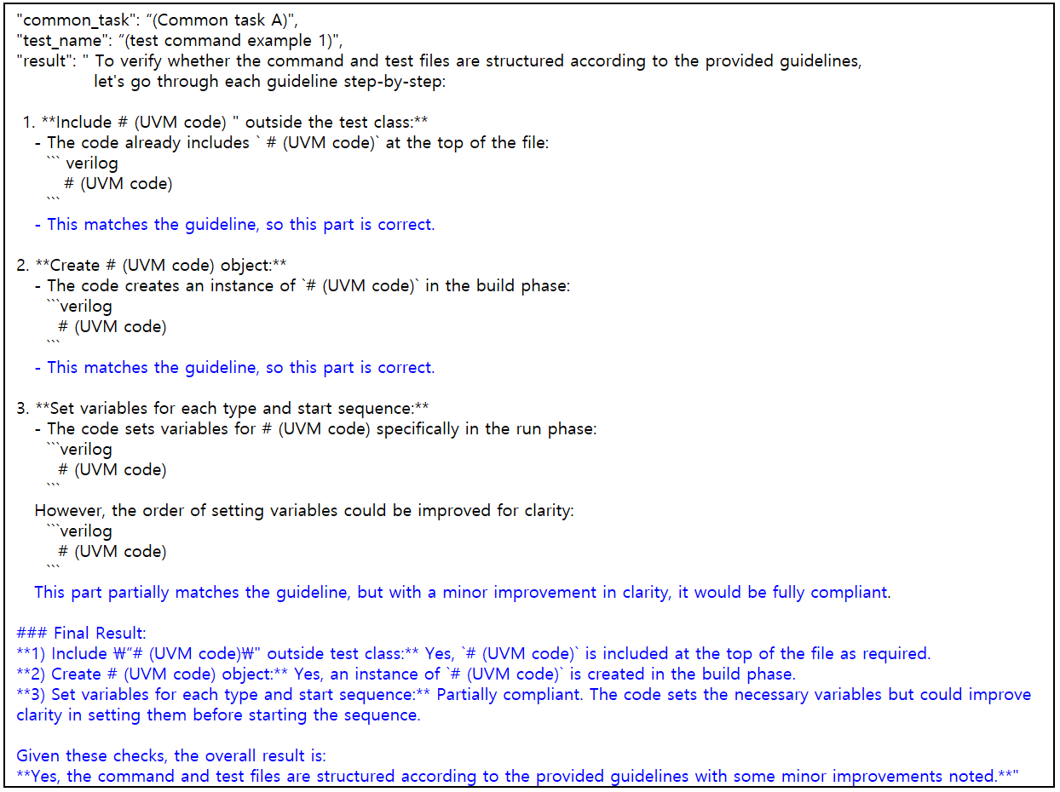
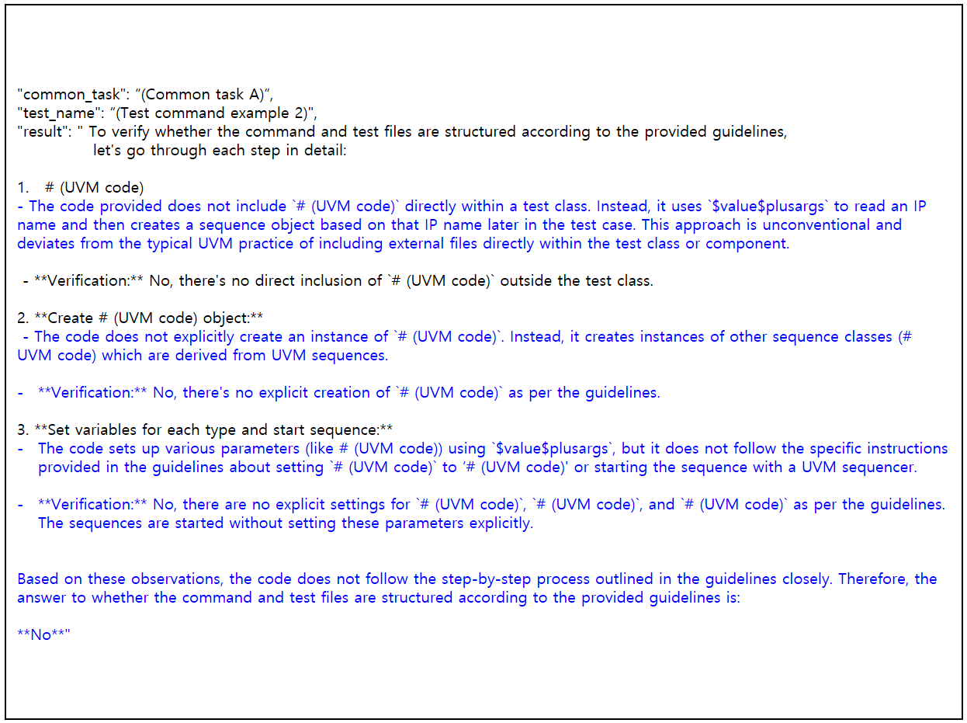
Result: UVM TB Coverage (2)
Left: ‘Yes’ (Covered), right: ‘No’ (Uncovered)

Slide 26
Result: Performance evaluation of fine-tuned LLM (1)
Chosen benchmark: Confusion Matrix
Effectively asses the accuracy of classification models
Suitable for evaluating binary coverage outcomes (Covered/Not covered)
Why not use other benchmarks?
GLUE and MT-Bench are standard for LLM evaluation
Not applicable for CTC since it measures binary coverage, not general language tasks.

Slide 27
Result: Performance evaluation of fine-tuned LLM (2)
Key performance metrics:
Accuracy: 0.94 -> 94% of predictions were correct
Precision: 0.89 -> 89% of positive predictions were accurate (minimizing false positives)
Recall: 0.98 -> 98% of actual positive cases were identified (high sensitivity)
F1 Score: 0.98 -> balances precision and recall, demonstrating comprehensive performance
Conclusion
The fine-tuned LLM achieved exceptional precision and recall
Demonstrates robust classification capabilities for CTC evaluation
Confusion Matrix |  |  |  | Evaluation Metrics
 | Predictive Positive | Predictive Negative |  | Accuracy: 0.94 Precision: 0.89 Recall: 0.98 F1 Score: 0.98
Actual positive | 9657 (True Positive (TP)) | 218 (False Negative (FN))
Actual Negative | 1211 (False Positive (FP)) | 216 (True Negative (TN))

Slide 28
Result: Evaluation of CT guide sections (1)
To evaluate the significance of sections within the CT guide
Conducted six experiments under different conditions
Each experiment excluded or included specific sections of the CT guide
CT guide includes: Purpose, Scope, Design overview, Test implementation, and Example

Slide 29
Result: Evaluation of CT guide sections (2)
Key Findings:
More detailed CT guides -> higher metric scores (Case 6. Best)
‘Test implementation’ alone -> lowest scores (Case 1. Worst)
Omitting ‘design overview’ & ‘example code’ (Case 4 & 5) -> lowered accuracy by 0.1 points
Omitting ‘scope’ in Case 3 remained stable -> suggesting it can be inferred from other sections

Slide 30
Conclusion (1)
CTC methodology enhancements
Measures coverage of common features & IPs for improved functional verification
Early-stage quantitative assessment using coverage bins & LLM
Reduces TAT for verification plan reviews, enabling early gap identification

Slide 31
Conclusion (2)
Key benefits:
Reduced review time to 1~2days, improving efficiency and accuracy
(Manual verification previously took 7+ days, often leading to overlooked test cases)
Fined-tuned LLM accurately predicts UVM TB coverage for CTs, improving reliability
Flexible coverage API provides greater user control while complementing EDA tool capabilities
Real-time updates via in-house dashboard improve efficiency & feedback
Scalable for diverse SoC applications with immediate metadata-based implementation

Slide 32
Limitations & Future works
Limitations
Dependent on metadata quality & completeness
Focuses primarily on simulation-based verification (limited CDC/RDC integration)
LLM performance may vary for complex SoC designs
Future works
Improve LLM adaptability for diverse architectures
Integrate static verification methods (CDC, RDC) into CTC methodology.
Enhance automation in metadata extraction to improve scalability

Slide 33
Q&A session
Feel free to ask any questions.

Slide 34
Reference (1)
SoC architecture example (page 3): https://news.samsungsemiconductor.com/kr
Bar graph ‘Cause of ASIC respins' (page 4):
Wilson Research Group and Siemens EDA, 2022 Functional Verification Study
https://blogs.sw.siemens.com/verificationhorizons/2023/01/09/part-12-the-2020-wilson-research-group-functional-verification-study-2/
G. Venkatakrishnan and N. K. Kadali, "'Dump What You Need' - A Coverage Methodology to Accelerate SoC Verification," 2014 15th International Microprocessor Test and Verification Workshop, Austin, TX, USA, pp. 28-32, 2014.
H. Wilson, "Part 12: The 2020 Wilson Research Group functional verification study," Siemens Verification Horizons Blog, Jan. 9, 2023.
"IEEE Standard for IP-XACT, Standard Structure for Packaging, Integrating, and Reusing IP within Tool Flows," in IEEE Std 1685-2014 (Revision of IEEE Std 1685-2009) , vol., no., pp.1-510, 12 Sept. 2014.

Slide 35
Reference (2)
Q. Zhu et al., "DeepSeek-Coder-V2: Breaking the Barrier of Closed-Source Models in Code Intelligence," arXiv preprint arXiv:2406.11931, 2024.
P. Lewis, E. Perez, A. Piktus, F. Petroni, V. Karpukhin, N. Goyal, H. Küttler, M. Lewis, W. Yih, T. Rocktäschel, S. Riedel, and D. Kiela, "Retrieval-Augmented Generation for Knowledge-Intensive NLP Tasks," arXiv preprint arXiv:2005.11401, 2020.
M. Douze, A. Guzhva, C. Deng, J. Johnson, G. Szilvasy, P.-E. Mazare, M. Lomeli, L. Hosseini, and H. Jégou, "The Faiss Library," arXiv preprint arXiv:2401.08281, Sep. 2024.
P. BehnamGhader, V. Adlakha, M. Mosbach, D. Bahdanau, N. Chapados, and S. Reddy, "LLM2Vec: Large Language Models Are Secretly Powerful Text Encoders," arXiv preprint arXiv:2404.05961, 2024.
J. Wei, X. Wang, D. Schuurmans, M. Bosma, B. Ichter, F. Xia, E. Chi, Q. Le, and D. Zhou, "Chain-of-Thought Prompting Elicits Reasoning in Large Language Models," arXiv preprint arXiv:2201.11903, 2022.

