Slide 1
Continuous Integration in SoC Design: Challenges and Solutions
Liu Wei, Li Jianjun, Yang Liangfeng, Li Liang
SDTECH Information Technology

Slide 2
INTRODUCTION
Continuous Integration (CI): frequent integration of code changes into a shared repository with automated builds and tests
CI has gradually been applied in the hardware development field, but implementing an efficient hardware continuous integration system still faces many challenges:
Incompatibility of HPC environments with mature CI tools, requiring additional dedicated computing resources, CI system with poor real-time performance and increased complexity
Deep integration of CI tools with Git, Requires many self-developed scripts in non-Git environments and cannot continuously follow the latest concepts and methods in the field of continuous integration, dedicated maintenance personnel
Performance degradation, binary file merge conflicts, and large file management challenges when using Git for chip design code

Slide 3
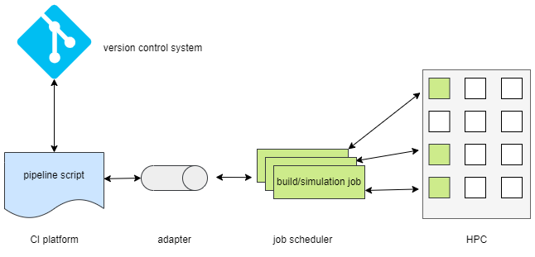
CI System Architecture for SOC design
Key Components of the CI System for SOC:
Version Control System, Stores chip design code, verification test cases, and configuration files, with Webhook trigger (e.g., GitLab, Bitbucket)
CI Platform: Provides pipeline scripts for executing tests, and monitors task status (e.g., GitLab CI, Jenkins)
Job Scheduling System: Manages and distributes parallel jobs to HPC (e.g., Slurm, LSF)
Command Adapter: Connects the CI system to the job scheduling system, translating CI platform commands to HPC commands (e.g., Jacamar CI)

Slide 4
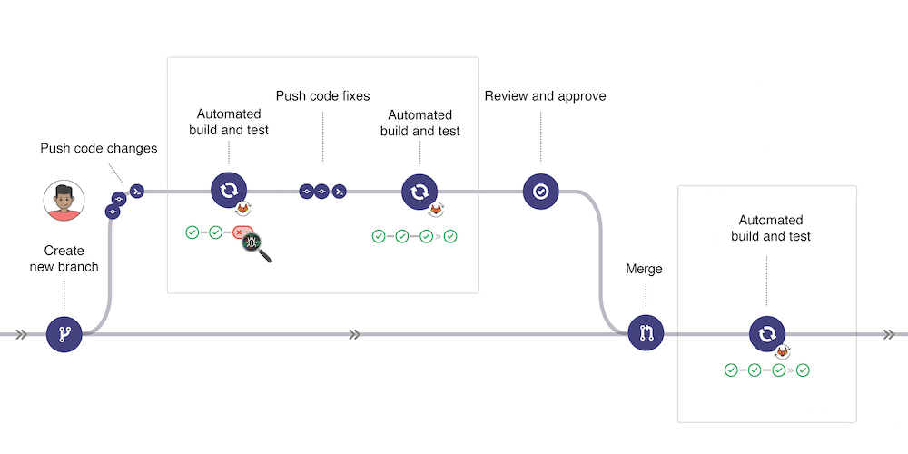
CI Process to Ensure Main Branch Availability
Main objective: CI Process to Ensure Main Branch is Always Available
Strategy: automatically run a set of tests, only merging into the main line if all tests pass.
CI tests cover multiple build and simulations at IP, subsystem, and SoC levels.

Slide 5
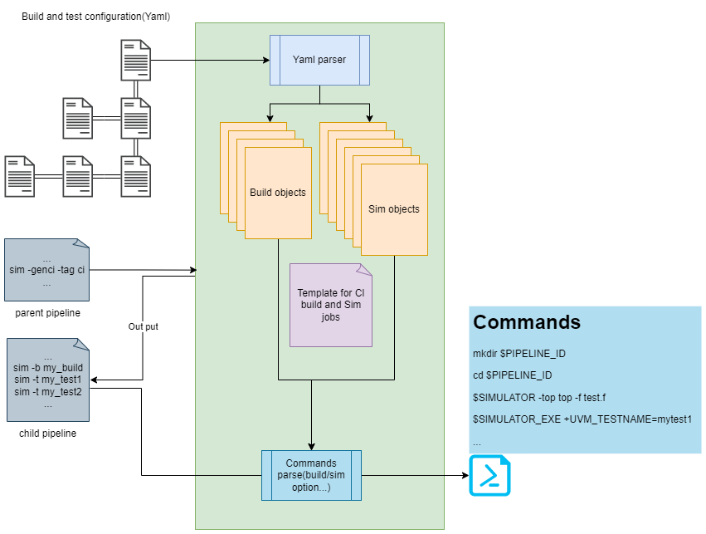
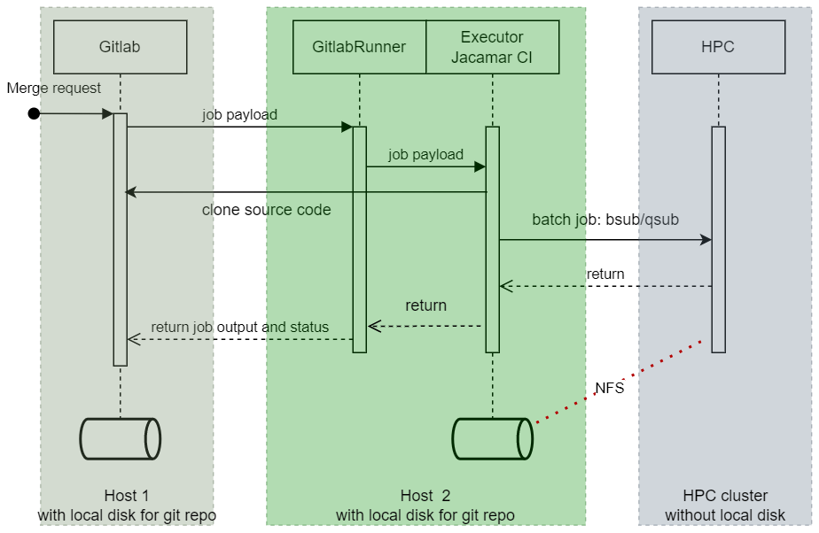
Implementation of the CI System
GitLab as the Git server, GitLab CI as the CI platform, and Jacamar CI as the adapter
GitLab Runner clones code, Jacamar CI submits jobs to HPC
Test results are returned to the GitLab page
Enhanced existing regression scripts commonly used in chip design and verification for CI
Use GitLab CI's parent-child pipeline mechanism
A timed script executed for deleting old code and logs

Slide 6
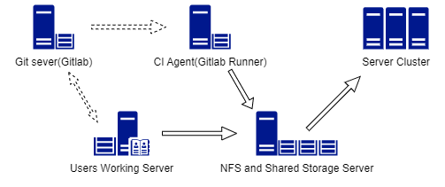
Git Challenges in SoC Projects and Resolutions
Git requires the use of local hard drives, while the chip design industry extensively uses network drives for storage. Therefore, adjustments to the IT infrastructure are needed.
Use git scalar and sparse checkout to optimize performance. Need Git version 2.38 or later.
Use Git LFS to manage large files.
Use LFS locking to resolve binary file conflicts
The Git server, CI runner and the user work server, have their own local storage for storing Git repositories locally.
the local storage of the CI runner and user work server needs to be shared to form the shared file system of the server cluster

Slide 7
Result and Conclusion
Implementation in a real project:
6Gb repository 41 developers
performed 3,303 merges
triggering 8,213 pipelines
with 6,743 successful completions and 1,344 failures.
the 1,344 early-caught failures represented over 3,360 hours of saved engineering time.
Conclusion:
The current Git can already meet the SOC design verification requirements.
CI tools based on Git ,Only minimal effort is required

Slide 8
Questions

