Slide 1

Technical Documents Version Management System Based on Large Language Models
Siarhei Zalivaka
SK hynix memory solutions Poland

Slide 2


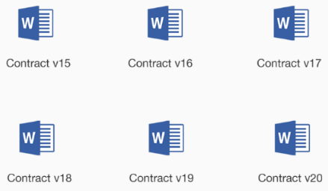


Background
M-PHY Version 5.0 – 232 pages
UFS Version 4.0 – 489 pages
Version 5.0 – 1299 pages
Version 3.0 – 288 pages

Slide 3



Existing Solution

Slide 4
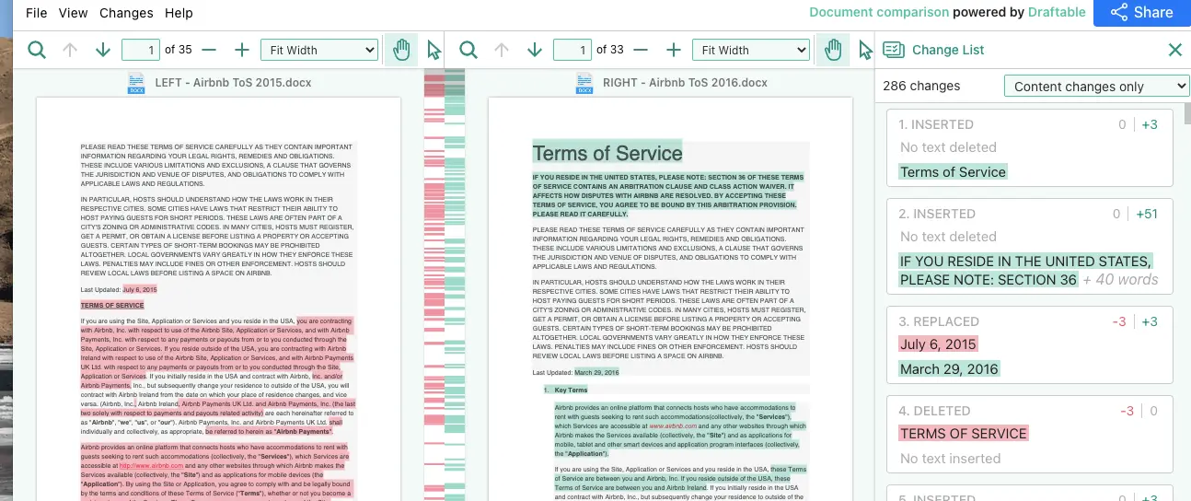

Document Versions comparison with LLMs

Slide 5
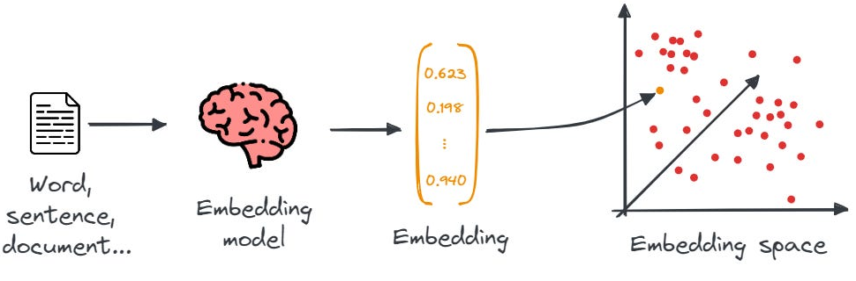
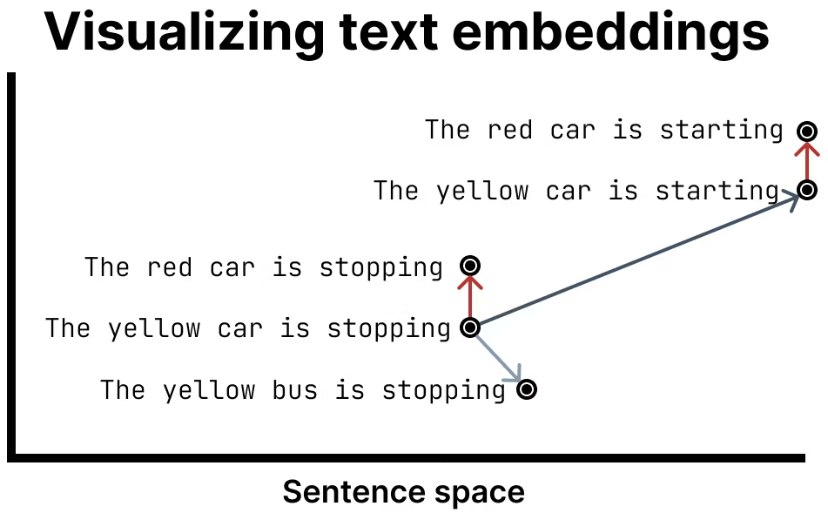
Embedding Vectors

Slide 6
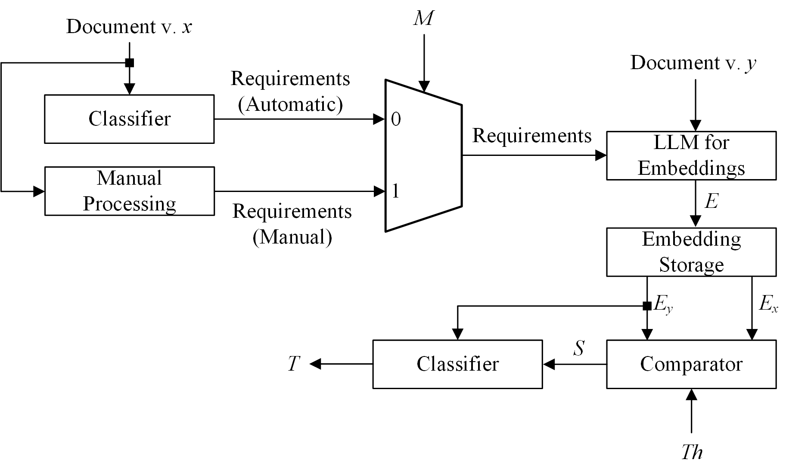

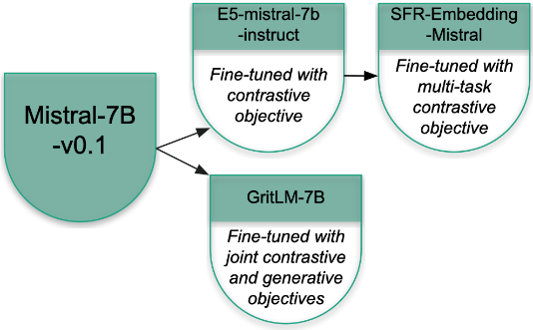
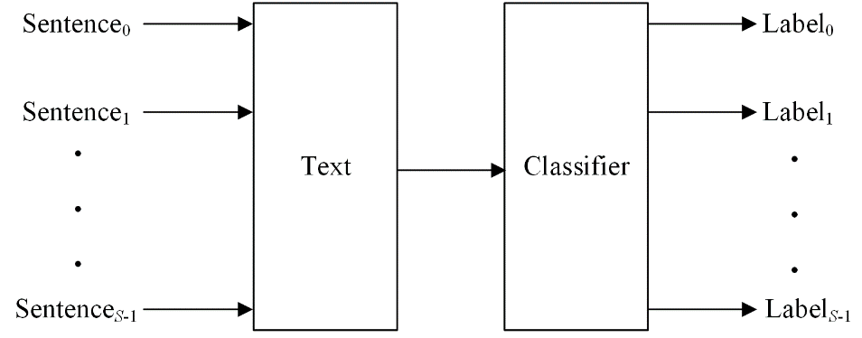

The proposed solution

Slide 7
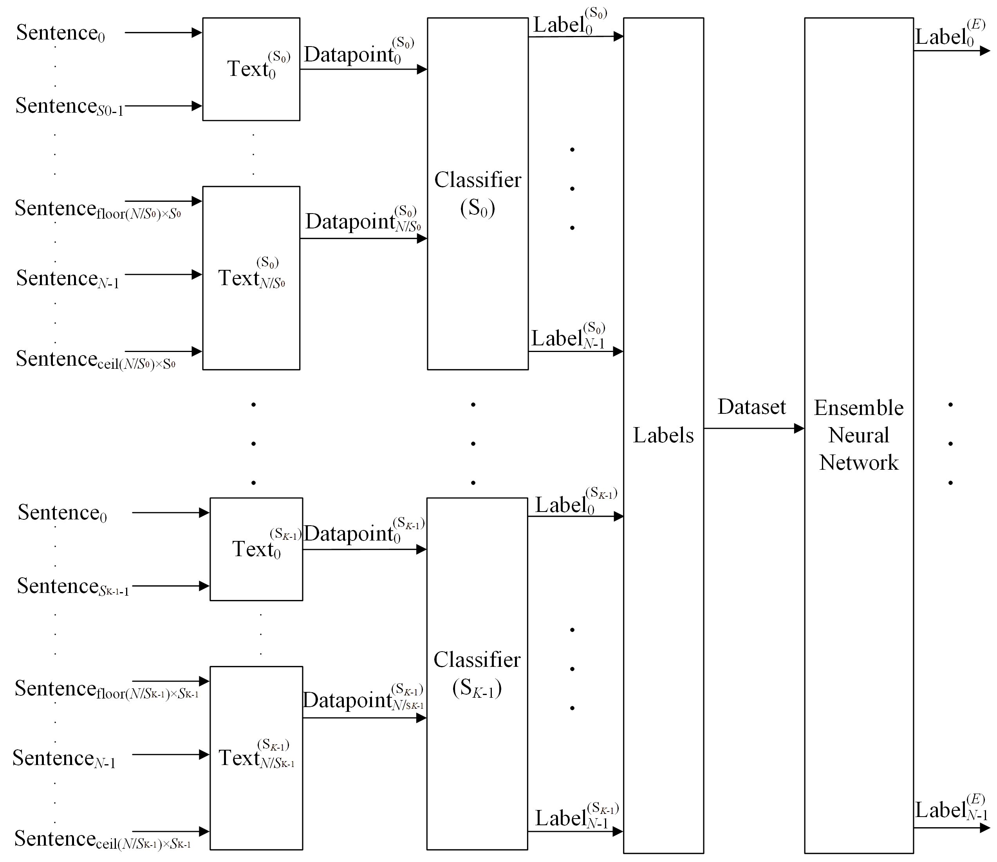
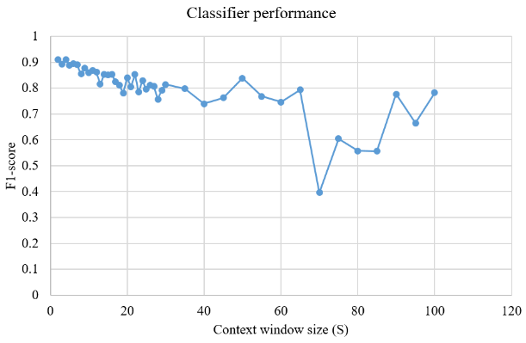
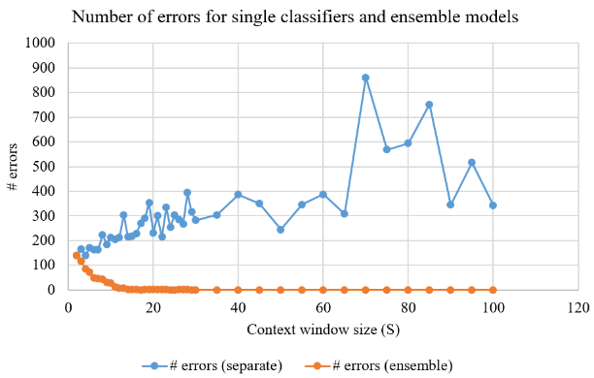
Classification Results Enhancement

Slide 8
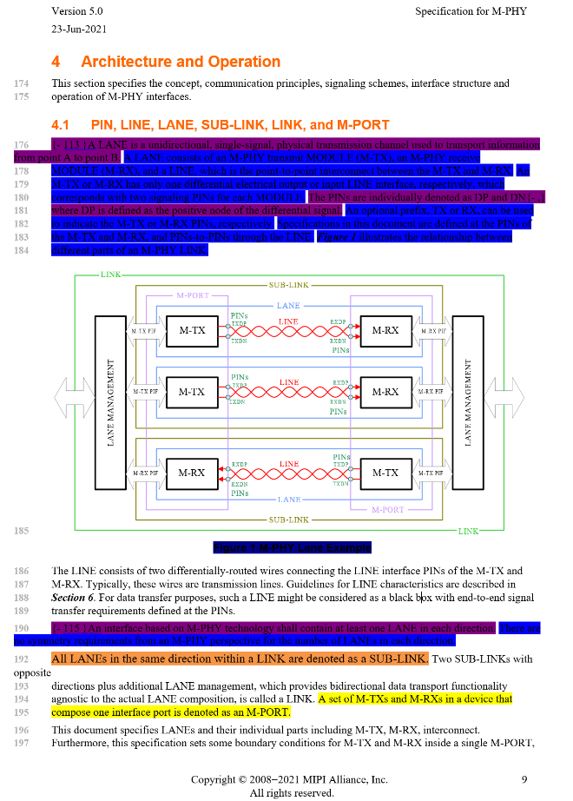
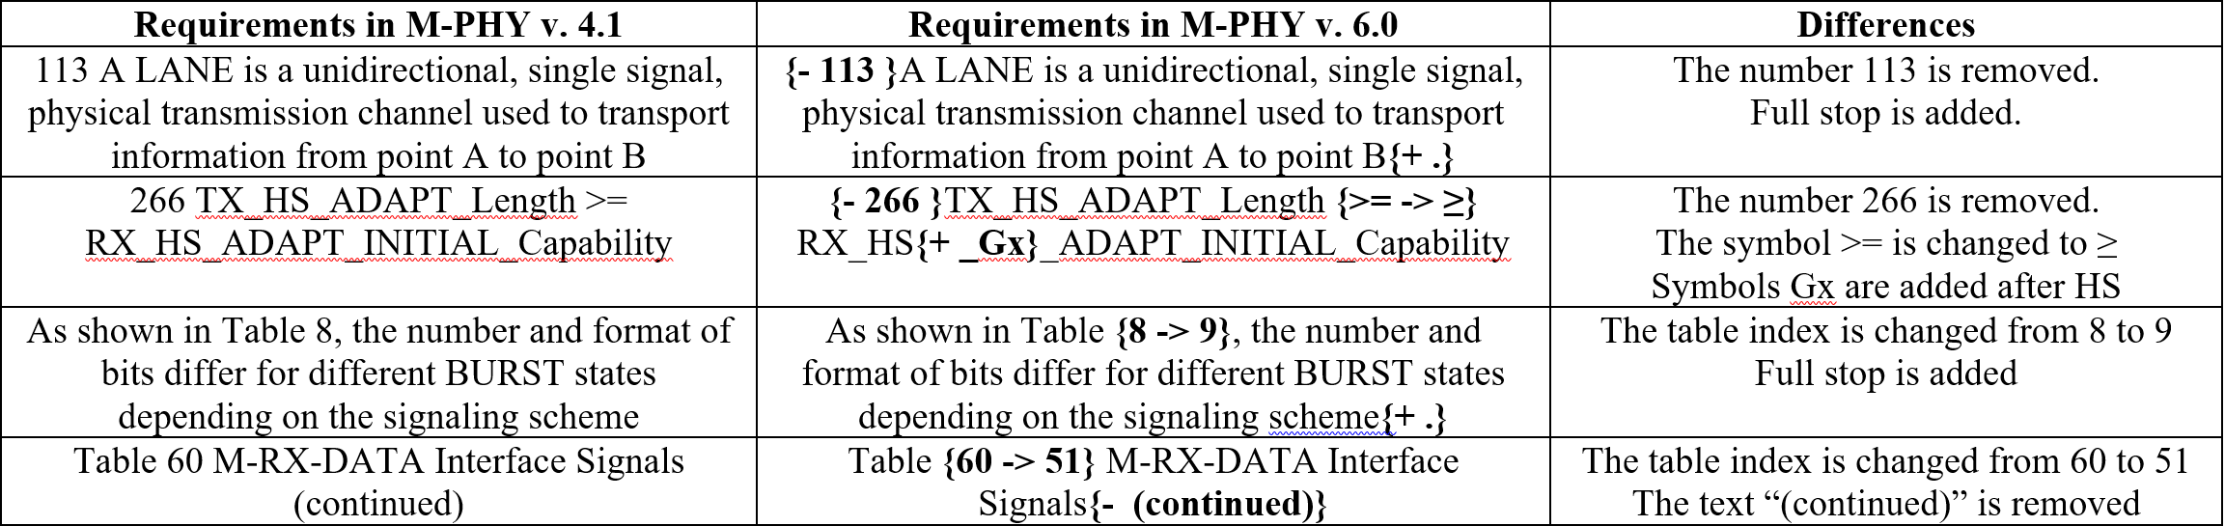
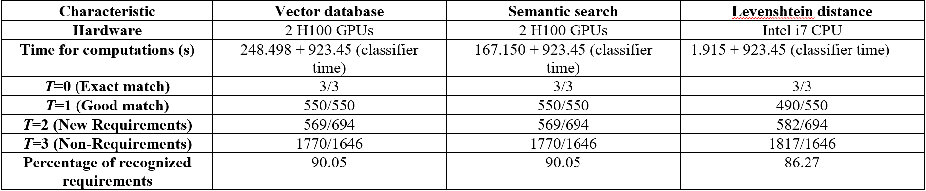
Experimental Results

Slide 9
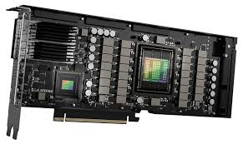



Experimental Setup
Nvidia H100 (x2)

Slide 10
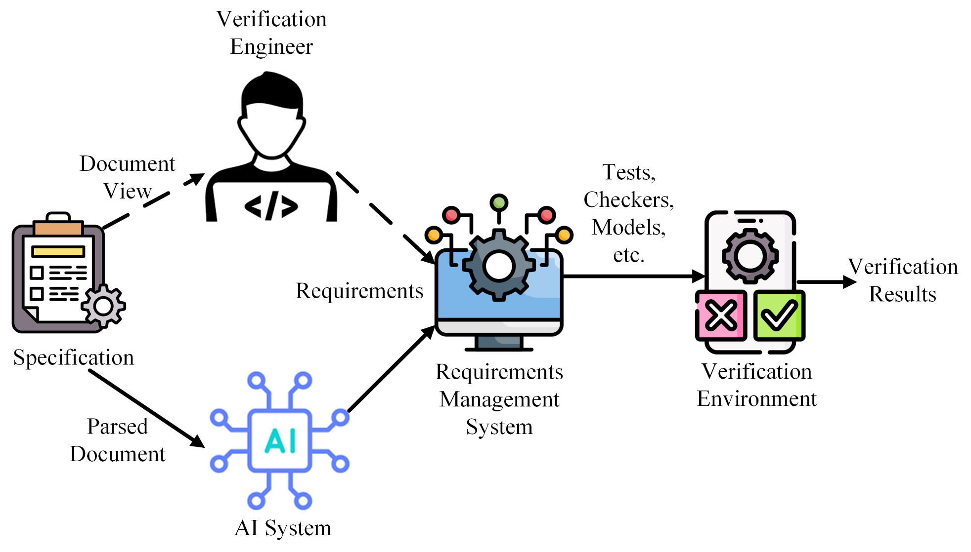
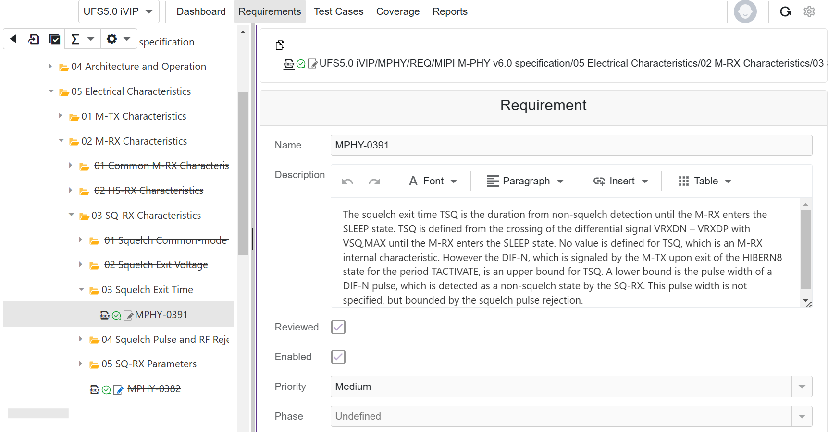
Verification Process Improvements

Slide 11
Conclusion
The achieved accuracy is around 90 %
The requirements from the previous version are found
The proposed solution gives valuable inputs to improve the routine verification process
The model still suffers from overfitting

Slide 12

Questions

