Slide 1
Accelerating the Functional Coverage through Machine Learning within a UVM Framework,
Syed Jawad, Majeed, Haroon, Nasir, Mahboob, Imran
NUST, DreamBig Semiconductors Inc

Slide 9
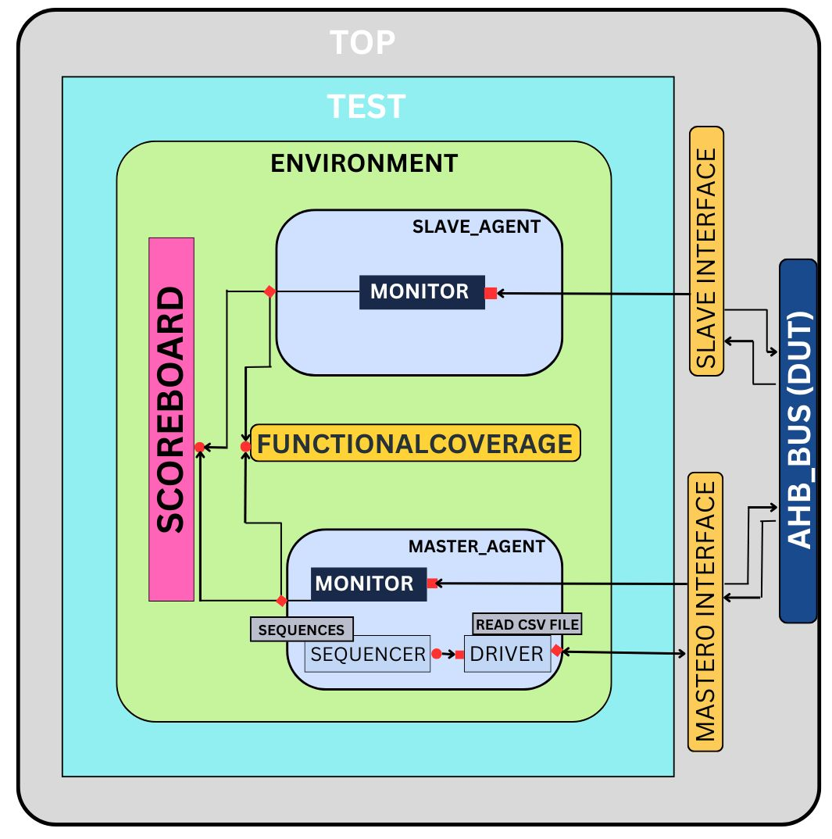
Conventional UVM Model
Test Bench Top
UVM TEST
UVM ENV
UVM AGENTS
UVM SCOREBOARD
FUNCTIONAL COVERAGE
INTERFACE
DUT

Slide 10
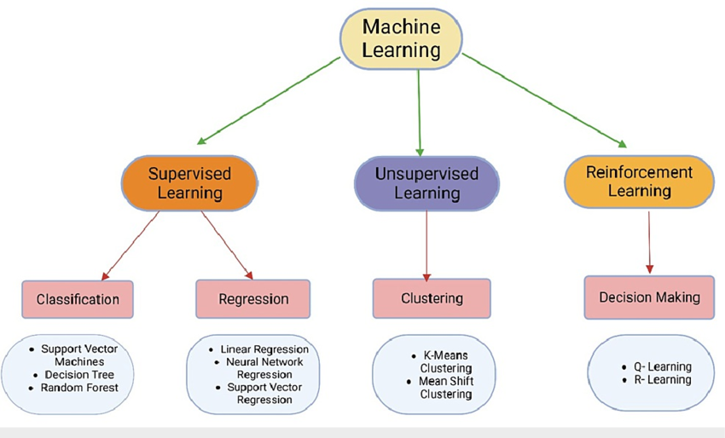
Machine Learning
Supervised learning
Unsupervised learning
Reinforcement learning

Slide 11
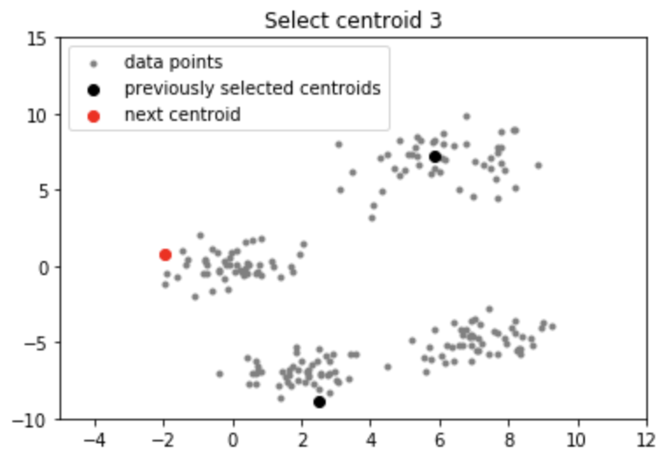
K mean++ algorithm
Enhances the traditional K-means algorithm by improving the initial selection of cluster centroids.

Slide 12
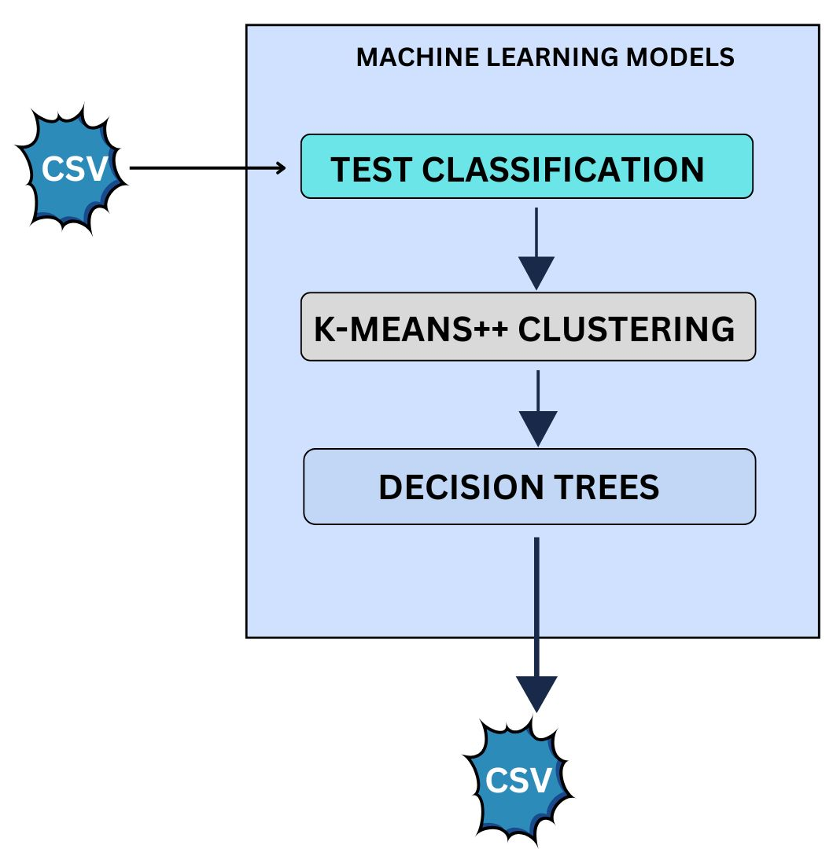
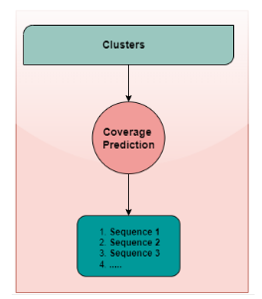
Proposed Working Model

Slide 13
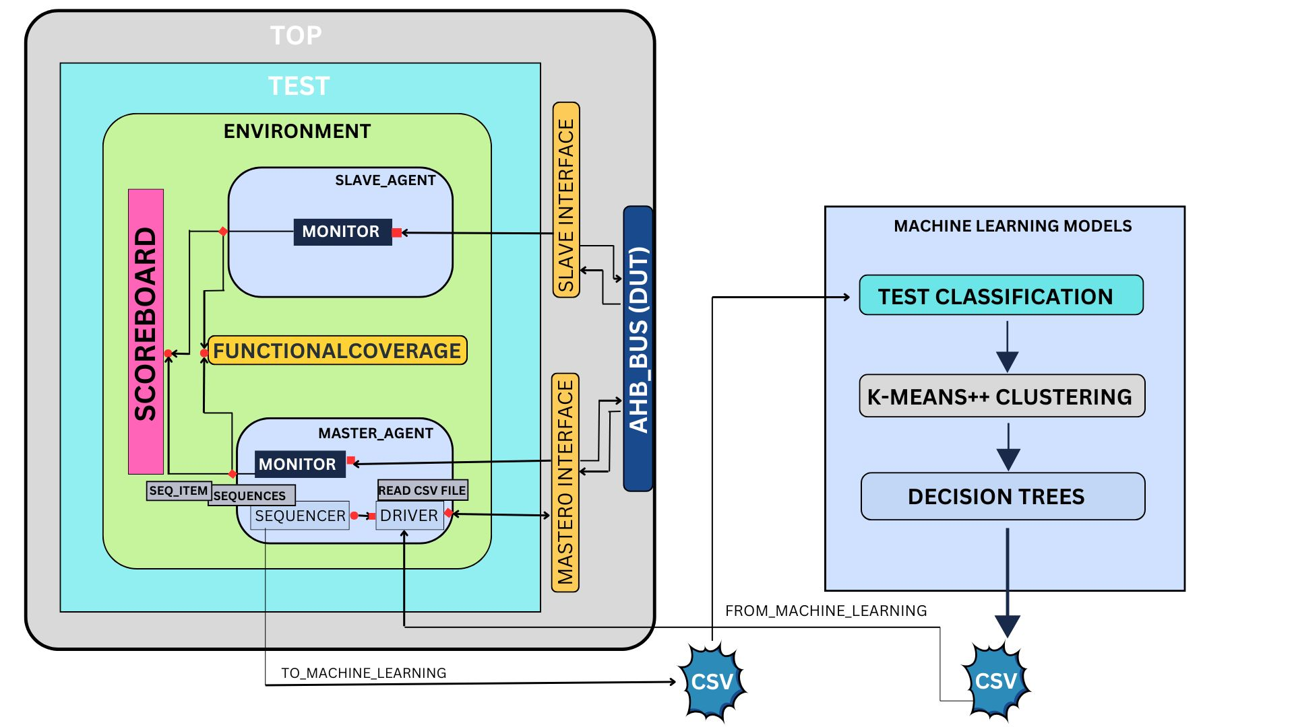
Integration of proposed ML model within a UVM framework
Complete verification flow with ML model.
CSV file generation through ML model.

Slide 14
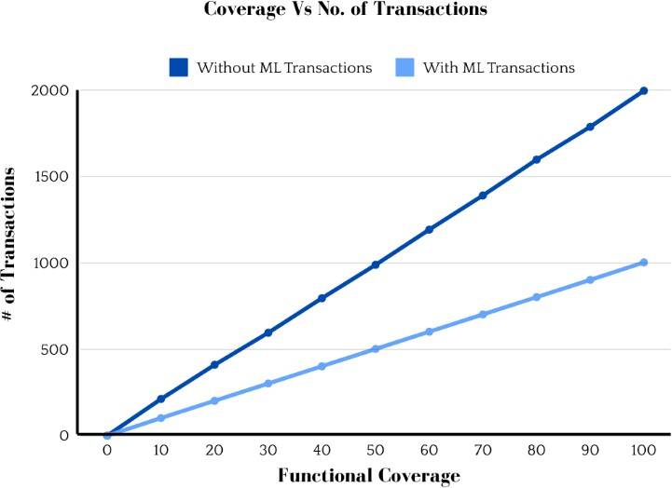
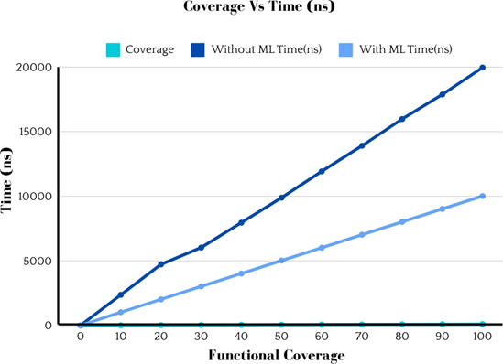
Performance Improvements:
Compare coverage results (with and without ML).

Slide 15
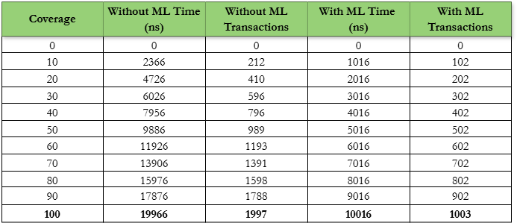
Compare coverage results in Table (with and without ML).

Slide 17
