Slide 1
Design Scheme for Emulator-friendly
Memory Verification IP
Sunghyeon Kang, Munsik Bae, SK hynix
Notes:
Hello everyone, /
My name is Sunghyun Kang, / and I work at SK Hynix.
Thank you all for being here today. /
In this presentation, I will discuss the design scheme for emulator-friendly memory VIP. /
Let's get started. /

Slide 2
Agenda
Challenges of Memory Controller SoC verification
Re-modeling Strategy
  Reducing Communication Overhead
  AC Timing Optimization
Experimental Results
Conclusion
Notes:
Here is the agenda for today's presentation:
First, I will discuss the challenges in verifying the latest memory controller SoC.
Next, I will introduce our proposed strategy to address these challenges.
Finally, I will present our experimental results and conclude with a summary.

Slide 3
Challenges of Memory Controller SoC Verification
Simulation Verification
Emulation Verification
Slow performance
→ Increase TAT
Limited random tests
→ Low coverage
One of the best ways to overcome these challenges is
verification with co-emulation
Notes:
As SoCs get more complex, verifying them has become much harder.
Simulation-based verification has slowed down a lot, which makes the overall Turn-Around Time (TAT) longer.
On the other hand, emulation-based verification struggles with running limited random tests, leading to low coverage.
An effective way to address these issues is to adopt co-emulation for verification.

Slide 4
What is Co-emulation?
Combination of simulation and emulation
  Synthesized DUT and timed area of TB in an emulator
  Compiled untimed area of TB in simulator
Advantages of co-emulation
  Rapid verification for highly complex SoCs
    Significantly reduce TAT for large-scale designs
  UVM-based testing in emulation
    Achieve high coverage efficiently
Source: Siemens EDA, “UVM Cookbook,” 2023, p. 350
Notes:
So, what exactly is co-emulation? Let's check out the image on the screen.
The top part shows a typical top-level environment, while the bottom part shows a co-emulation setup.
In the bottom diagram, the timed operations of the testbench (TB) are moved to the BFM interface in the HDL domain.
These are synthesized with the Design Under Test (DUT) inside the emulator, resulting in acceleration.
Meanwhile, the untimed part of the TB is compiled separately.
This method has a lot of benefits.
First, it allows for much faster verification of complex SoCs.
Second, you can perform UVM-based testing within the emulator.
These advantages greatly reduce Turn-Around Time (TAT) and improve verification coverage.

Slide 5
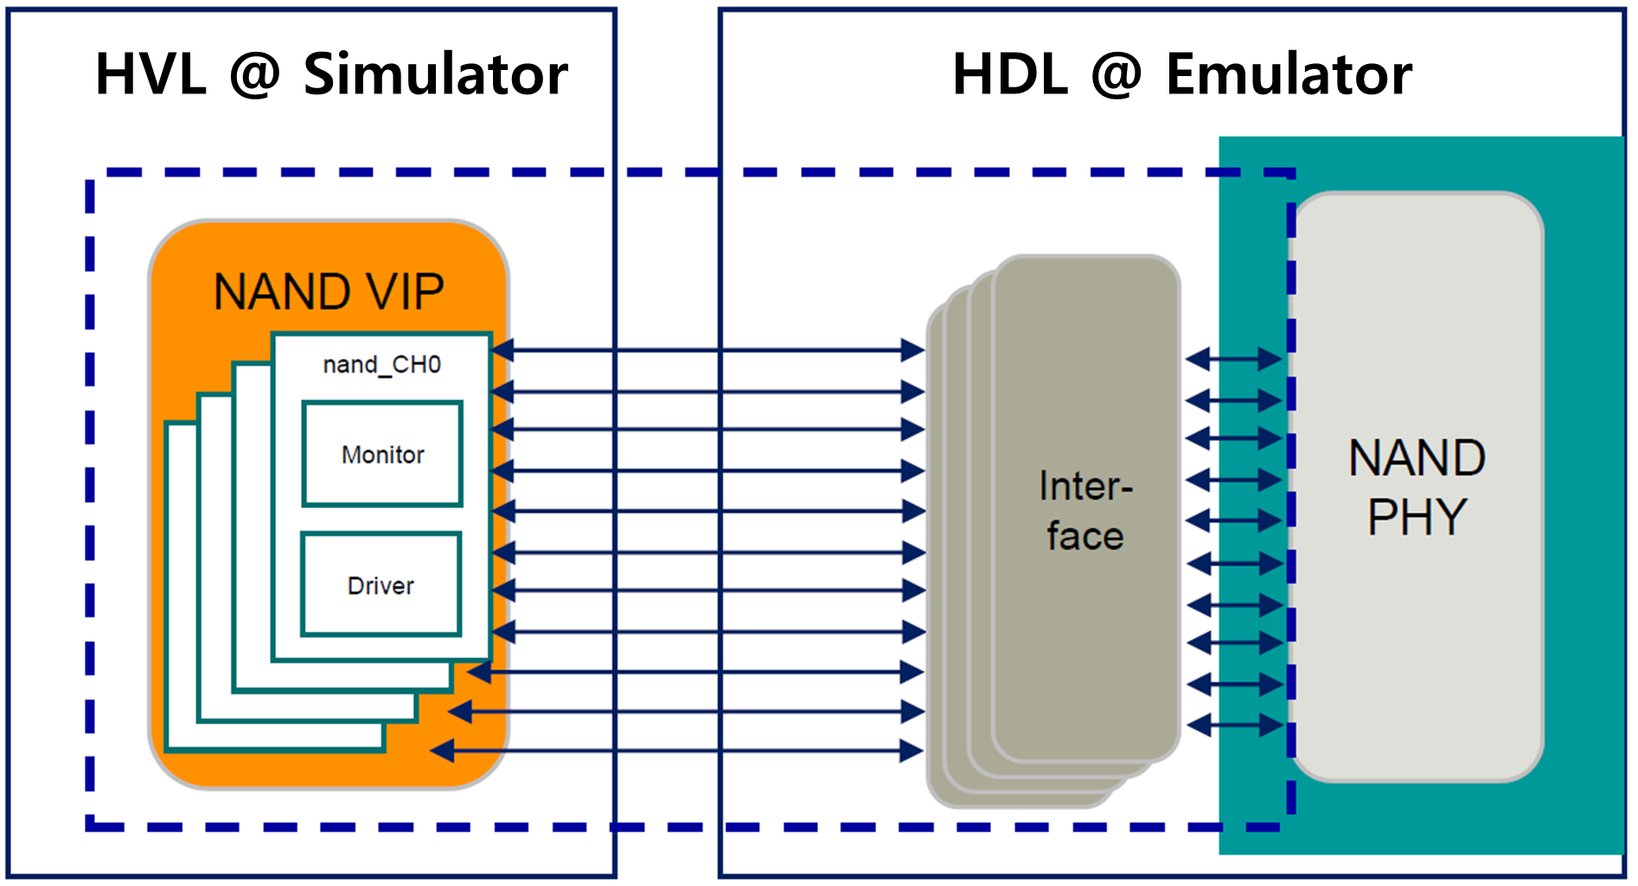
Challenges in Co-emulation with Memory VIP
Limitations with existing simulation models
  A major cause of performance degradation
    Excessive HDL <-> HVL communication
  Inevitable time-consuming logic
    In the NOT ACCELERATED area
Limitations of EDA support
  Vendor-specific operations
  Undefined specifications of next-gen NAND
Notes:
However, there are several challenges in applying co-emulation to Memory controller SoCs especially for NAND
First, using existing simulation models is challenging.
This is because these models are often impacted by performance bottlenecks, such as excessive communication between HDL and HVL.
Also, there are many time-consuming operations to mimic memory behavior, which are not allowed in co-emulation.
Moving them to the emulator side is mandatory for acceleration.
Second, there are limitations in EDA support. Although EDA vendors provide various solutions for co-emulation, they are unable to offer robust solutions for NAND.
The main reason for this is that NAND involves many memory vendor-specific operations.
Moreover, the specifications for future NAND generations remain unclear.
These make it difficult for EDA vendors to develop effective NAND solutions.
However, there are some challenges when applying co-emulation with memory controller SoCs, especially for NAND.
First, using existing simulation models can be tough.
This is because these models often suffer from performance issues, like too much communication between HDL and HVL.
Also, There are many time-consuming operations, which are not allowed in co-emulation.
They must be moved to the emulator side.
Second, there are limitations in EDA support. Although EDA vendors provide various solutions for co-emulation, they are unable to offer robust solutions for NAND.
This is mainly because NAND involves many operations that are specific to different memory vendors, and the future specifications for NAND are still unclear.
These factors make it hard for EDA vendors to create effective solutions for NAND.
<2.1 배>
First, …..
Script에서 잦은 (빈번한) communication 이 문제이지 much communication은 문제가 되지 않습니다.
Using existing simulation models can be tough 명확하지 않고 필요 없어 보이는 문장입니다. 차라리 first 보다 앞서 설명되어야 할 것 같습니다.
Also..
(강) 대신 ‘time-consuming operation은 co-emul에서 허용이 안되는데 기존 model에 많이 있다’ 이런 식으로 풀어가려고 합니다.
기존 모델에 time-consuming operation 이 많이 있어 (최상위 제목인) limitation에 어떠한 영향 (또는 왜?) 을 끼치는가? 고치는데 overhead 인가? 어떻게 풀어가야 할지 잘 모르겠습니다. 일단 an intolerable overhead 도 맞아 보이지 않습니다.
풀어내는게 어려워서 문제이긴 하지만 저 부분이 중요하기도 합니다.
An intolerable overhead →
Inevitable time-consuming logic
In the NOT ACCELERATED area
그리고 script는 아래와 같이 설명되어야 할 것 같습니다.
‘Memory model에는 device의 동작을 mimic하기 위한 time-consuming logic들이 많이 있다. 문제는 이 부분이 가속화 될 수 없는 simulation 영역에 있다는 것이다. 가속화가 가능한 emulator 영역으로 옮기는 작업은 필연적이다.’
<2.2 강>
피드백 반영했습니다.
스크립트 업데이트 했습니다.
However, there are several challenges in applying co-emulation to Memory controller SoCs especially for NAND
First, using existing simulation models is challenging.
This is because these models are often impacted by performance bottlenecks, such as excessive communication between HDL and HVL.
Also, there are many time-consuming operations to mimic memory behavior, which are not allowed in co-emulation.
Moving them to the emulator side is mandatory for acceleration.
Second, there are limitations in EDA support. Although EDA vendors provide various solutions for co-emulation, they are unable to offer robust solutions for NAND.
The main reason for this is that NAND involves many memory vendor-specific operations.
Moreover, the specifications for future NAND generations remain unclear.
These make it difficult for EDA vendors to develop effective NAND solutions.

Slide 6
Needs for Customized VIP
Emulator-friendly with high performance
Effortless support for the vendor-specific commands
Quick adaptation to frequently changing memory specifications
Notes:
Therefore, a customized Memory VIP is needed.
This VIP is designed to work well with emulators, ensuring it performs at a high level.
It also easily supports confidential operations and can quickly adjust to changes in Memory specifications.

Slide 7
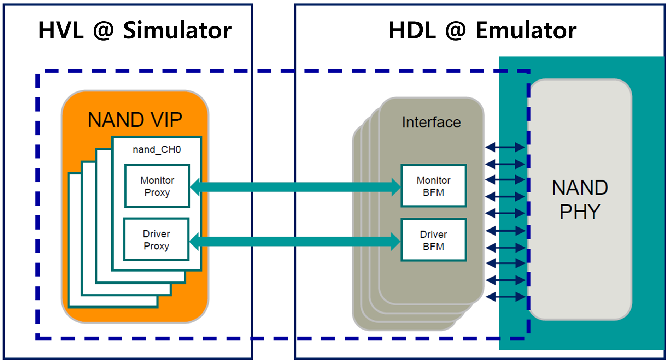
Key Concept : Delegating Core Operations to HDL Interface
Notes:
The main idea of our proposed model / is to move the core functions of the HVL driver / to the HDL interface.
This allows the driver's main tasks to run faster in the emulator

Slide 8
Block Diagram of Our Proposed Design
Notes:
Here is the overall block diagram of our proposed model.
As shown, most of the HVL functions have been recreated in the HDL interface.
Let's go through our strategies one step at a time.

Slide 9
Design Scheme to Reduce # of Communication
Previous re-modeled
  Excessive Communication Between HVL and HDL
  Numerous timed operations
  No data array in HDL interface
HDL TOP (Emulator)
HVL TOP (Simulator)
Interface
NAND Driver
for begin
@(vif.dqs);
vif.io <= dat[i];
#(t.QH);
vif.io <= ‘hz;
end
Data Array
Notes:
First, we need to cut down on the excessive communication between HDL and HVL.
In the previous model, communication happened every time the DQS changed inside a for loop.
There were also many time-consuming operations, like #delay.
As I mentioned earlier, these are major reasons for the drop in performance.

Slide 10
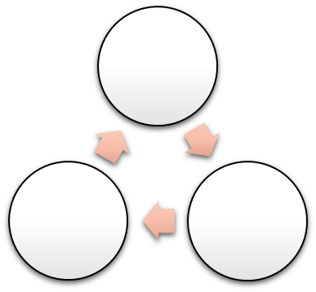
Design Scheme to Reduce # of Communication
After re-modeled
  Designing synthesizable logics in the interface
    Based on FSM
    Responsible for DUT driving
  Remaining only few roles in the driver
    Set data and delays before trigger
    Call trigger and wait_end tasks
HDL TOP (Emulator)
HVL TOP (Simulator)
Interface
NAND Driver
vif.set_rd_dat(dat);
vif.set_dly(“QH”, 100);
vif.trigger();
vif.wait_end();
Main FSM
Data Array
Data Array
Notes:
Let's check out the next diagram. The main tasks of the HVL driver have been reworked into synthesizable logic within the HDL interface.
This new setup uses an FSM and fully handles driving to the DUT.
As a result, the driver no longer has its main roles and now only does the initial setup and starts the main FSM.

Slide 11
Design Scheme to Reduce # of Communication
After re-modeled (cont.)
  Using allowed bandwidth efficiently
    e.g. call the set_rd_dat() function 144 times per single page read
  Data transfer in IDLE state
HDL TOP (Emulator)
HVL TOP (Simulator)
Interface
NAND Driver
vif.set_rd_dat(dat);
vif.set_dly(“QH”, 100);
vif.trigger();
vif.wait_end();
Main FSM
HDL Emulator Side
HVL Simulator Side
Accelerated Interface
PGM
Non-accelerated driver
Data Array
Data Array
Data Array
Memory
Read
Notes:
Also, data arrays are added to the HDL interface.
In the previous model, 16K bytes of data were sent one byte at a time in a loop.
Now, with high-bandwidth communication, data transfer is finished with only 144 function calls in the HDL interface in the IDLE state.
These methods significantly cut down the number of interactions between HDL and HVL.

Slide 12
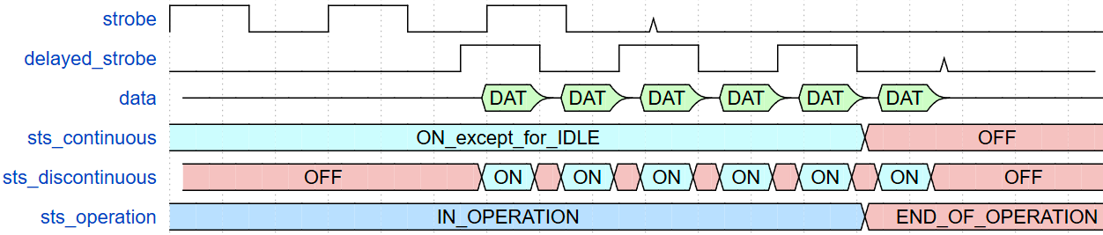
AC Timing Optimization Strategy
Continuous delay
Discontinuous delay
Used to generate delayed signals
Needed each cycle or strobe
Used to all other functions
Needed only at certain points
Continuous delay
Continuous delay
Discontinuous delay
Notes:
The next strategy focuses on optimizing delays.
In our model, delays are categorized into two types : continuous and discontinuous.
Take a look at the waveform.
It illustrates how these delays are applied during the process.
The continuous delays are used to generate the delayed strobe, and they are applied throughout the entire operation.
In contrast, the discontinuous delays are used in all other operations.
This diagram shows an example of creating data valid windows using the delays. They are only used at specific times.

Slide 13
AC Timing Optimization Strategy
Previous re-modeled
  Using delay statements
HDL TOP (Emulator)
HVL TOP (Simulator)
Interface
NAND Driver
task drv_dq();
for begin
@(vif.dqs);
vif.io <= dat[i];
#(t.QH);
vif.io <= ‘hz;
end
task drv_dqs();
for begin
@(vif.reb);
vif.dqs <=
#(tDQSRE) vif.reb;
end
Notes:
In the previous model, all delays are designed by # delay.

Slide 14
AC Timing Optimization Strategy
After re-modeled
  Continuous delay
    Shift registers
  Discontinuous delay
    AC timer
HDL TOP (Emulator)
HVL TOP (Simulator)
Interface
NAND Driver
vif.set_rd_dat(dat);
vif.set_dly(“QH”, 100);
vif.trigger();
vif.wait_end();
Timer FSM
Shift Register
Notes:
In the updated model, we use an AC timer to manage discontinuous delays, and continuous delays are handled with shift registers.

Slide 15
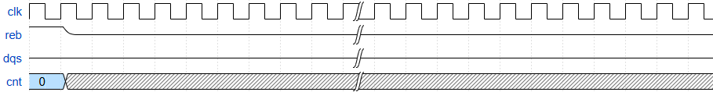
Continuous Delay Using Shift Registers
Handle continuous delays such as tDQSRE
DQS is generated after target delay
Use a reference clock in the emulator
Time of tDQSRE
Shift Regs | 1 |  |  |  |  |  |  |  |  | · · · · · |  |  |  |  |  | T
Notes:
The shift register are used to manage continuous delays.
They works with a reference clock in the emulator.
When the 'reb' signal reaches the target, a delayed strobe is produced.
Let's examine the diagram.
Initially, an 'reb' signal comes in. Since it hasn't hit the target yet, 'dqs' keeps its previous value.

Slide 16
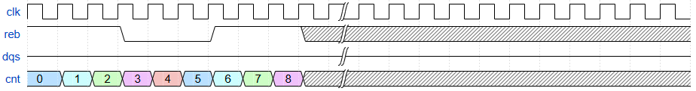
Continuous Delay Using Shift Registers
Handle continuous delays such as tDQSRE
DQS is generated after target delay
Use a reference clock in the emulator
Time of tDQSRE
Shift Reg | 1 | 1 | 1 | 0 | 0 | 0 | 1 | 1 | 1 | · · · · · |  |  |  |  |  | T
Notes:
Now, nine 'reb' signals have entered the shift register.
However, because the target hasn't been reached yet, 'dqs' doesn't produce any output value.

Slide 17
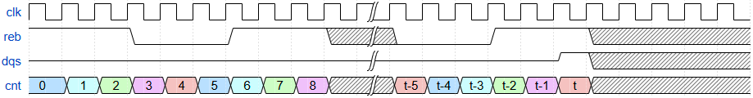
Continuous Delay Using Shift Registers
Handle continuous delays such as tDQSRE
DQS is generated after target delay
Use a reference clock in the emulator
Time of tDQSRE
Shift Regs | 1 | 1 | 1 | 0 | 0 | 0 | 1 | 1 | 1 | · · · · · | 0 | 0 | 0 | 1 | 1 | 1
Notes:
Finally, the target is reached. At this point, 'dqs' is sent to the DUT.

Slide 18
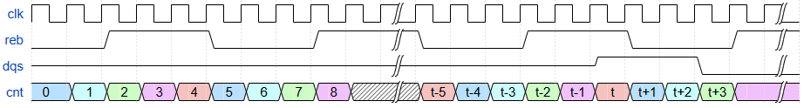
Continuous Delay Using Shift Registers
Handle continuous delays such as tDQSRE
DQS is generated after target delay
Use a reference clock in the emulator
Time of tDQSRE
Shift Regs | 0 | 0 | 1 | 1 | 1 | 0 | 0 | 0 | 1 | · · · · · | 1 | 1 | 0 | 0 | 0 | 1 | 1 | 1 | 0
Notes:
Each 'reb' that hits the target is sent out one by one through 'dqs'. This is how the delayed strobe is generated by using the shift registers

Slide 19
Non-continuous Delay Using AC Timer
Used for processing one-time delays
Based on an FSM
Activated during the main operation
Set target delays before starting the main OP FSM
Trigger AC timer from Main FSM
IDLE
SET
CNT
DONE
CHECK
Notes:
The AC Timer is used for processing one-time delays.
It works based on an FSM, as illustrated in the diagram.
This timer is activated whenever a delay is needed during the main operation.
The HVL driver sets the delay values before the main FSM starts

Slide 20
Main Operation Example - Page Read
Call trigger_fsm() from driver
IDLE
WAIT
Exit from any state
Transfer Ready
EXIT
DRIVE
Transfer Ready
Backpressure
PAUSE
Notes:
Let's take a look at how the model works using a simple example of a read operation.
The diagram displays the main operation FSM. I will explain the details step by step, following how the FSM operates.

Slide 21
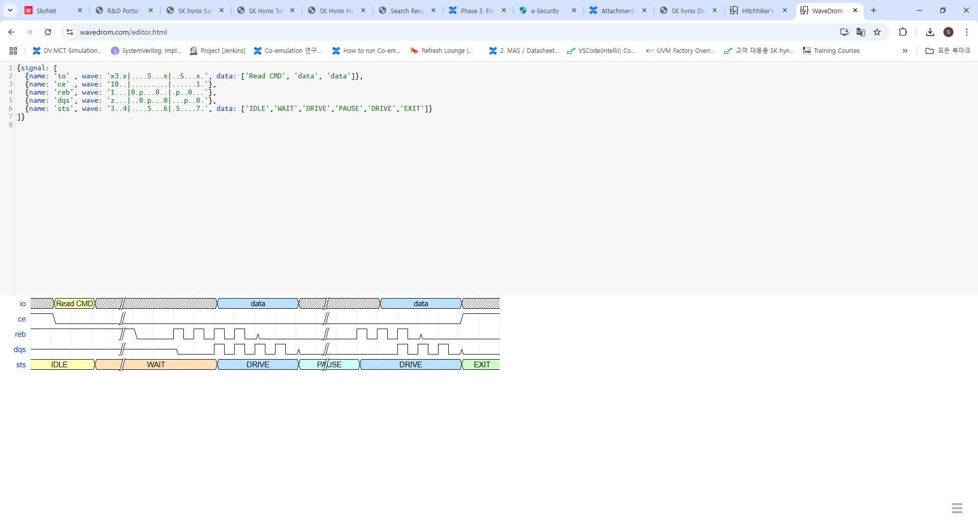
Main Operation Example - IDLE State
HDL interface
HVL driver
Get data from the driver
Activate the main OP FSM
Wait for command decoding
Transmit data to the interface
Call trigger_fsm task
Notes:
In the Idle state, the HVL driver is on standby, waiting for the NAND command to be decoded.
After decoding, the page data and target delays are sent to the HDL interface.
This action triggers the main operation FSM. Then, the HDL gets the data and starts the FSM.

Slide 22
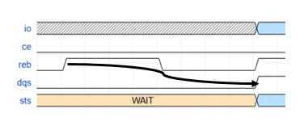
Main Operation Example – WAIT State
HDL interface
HVL driver
Wait for delays
Activate the shift registers
Nothing to do
tDQSRE
Notes:
From the WAIT state, the HVL driver does not perform any actions.
The HDL interface waits for a couple of delays and then activates the shift registers to generate delayed strobe signal such as dqs.

Slide 23
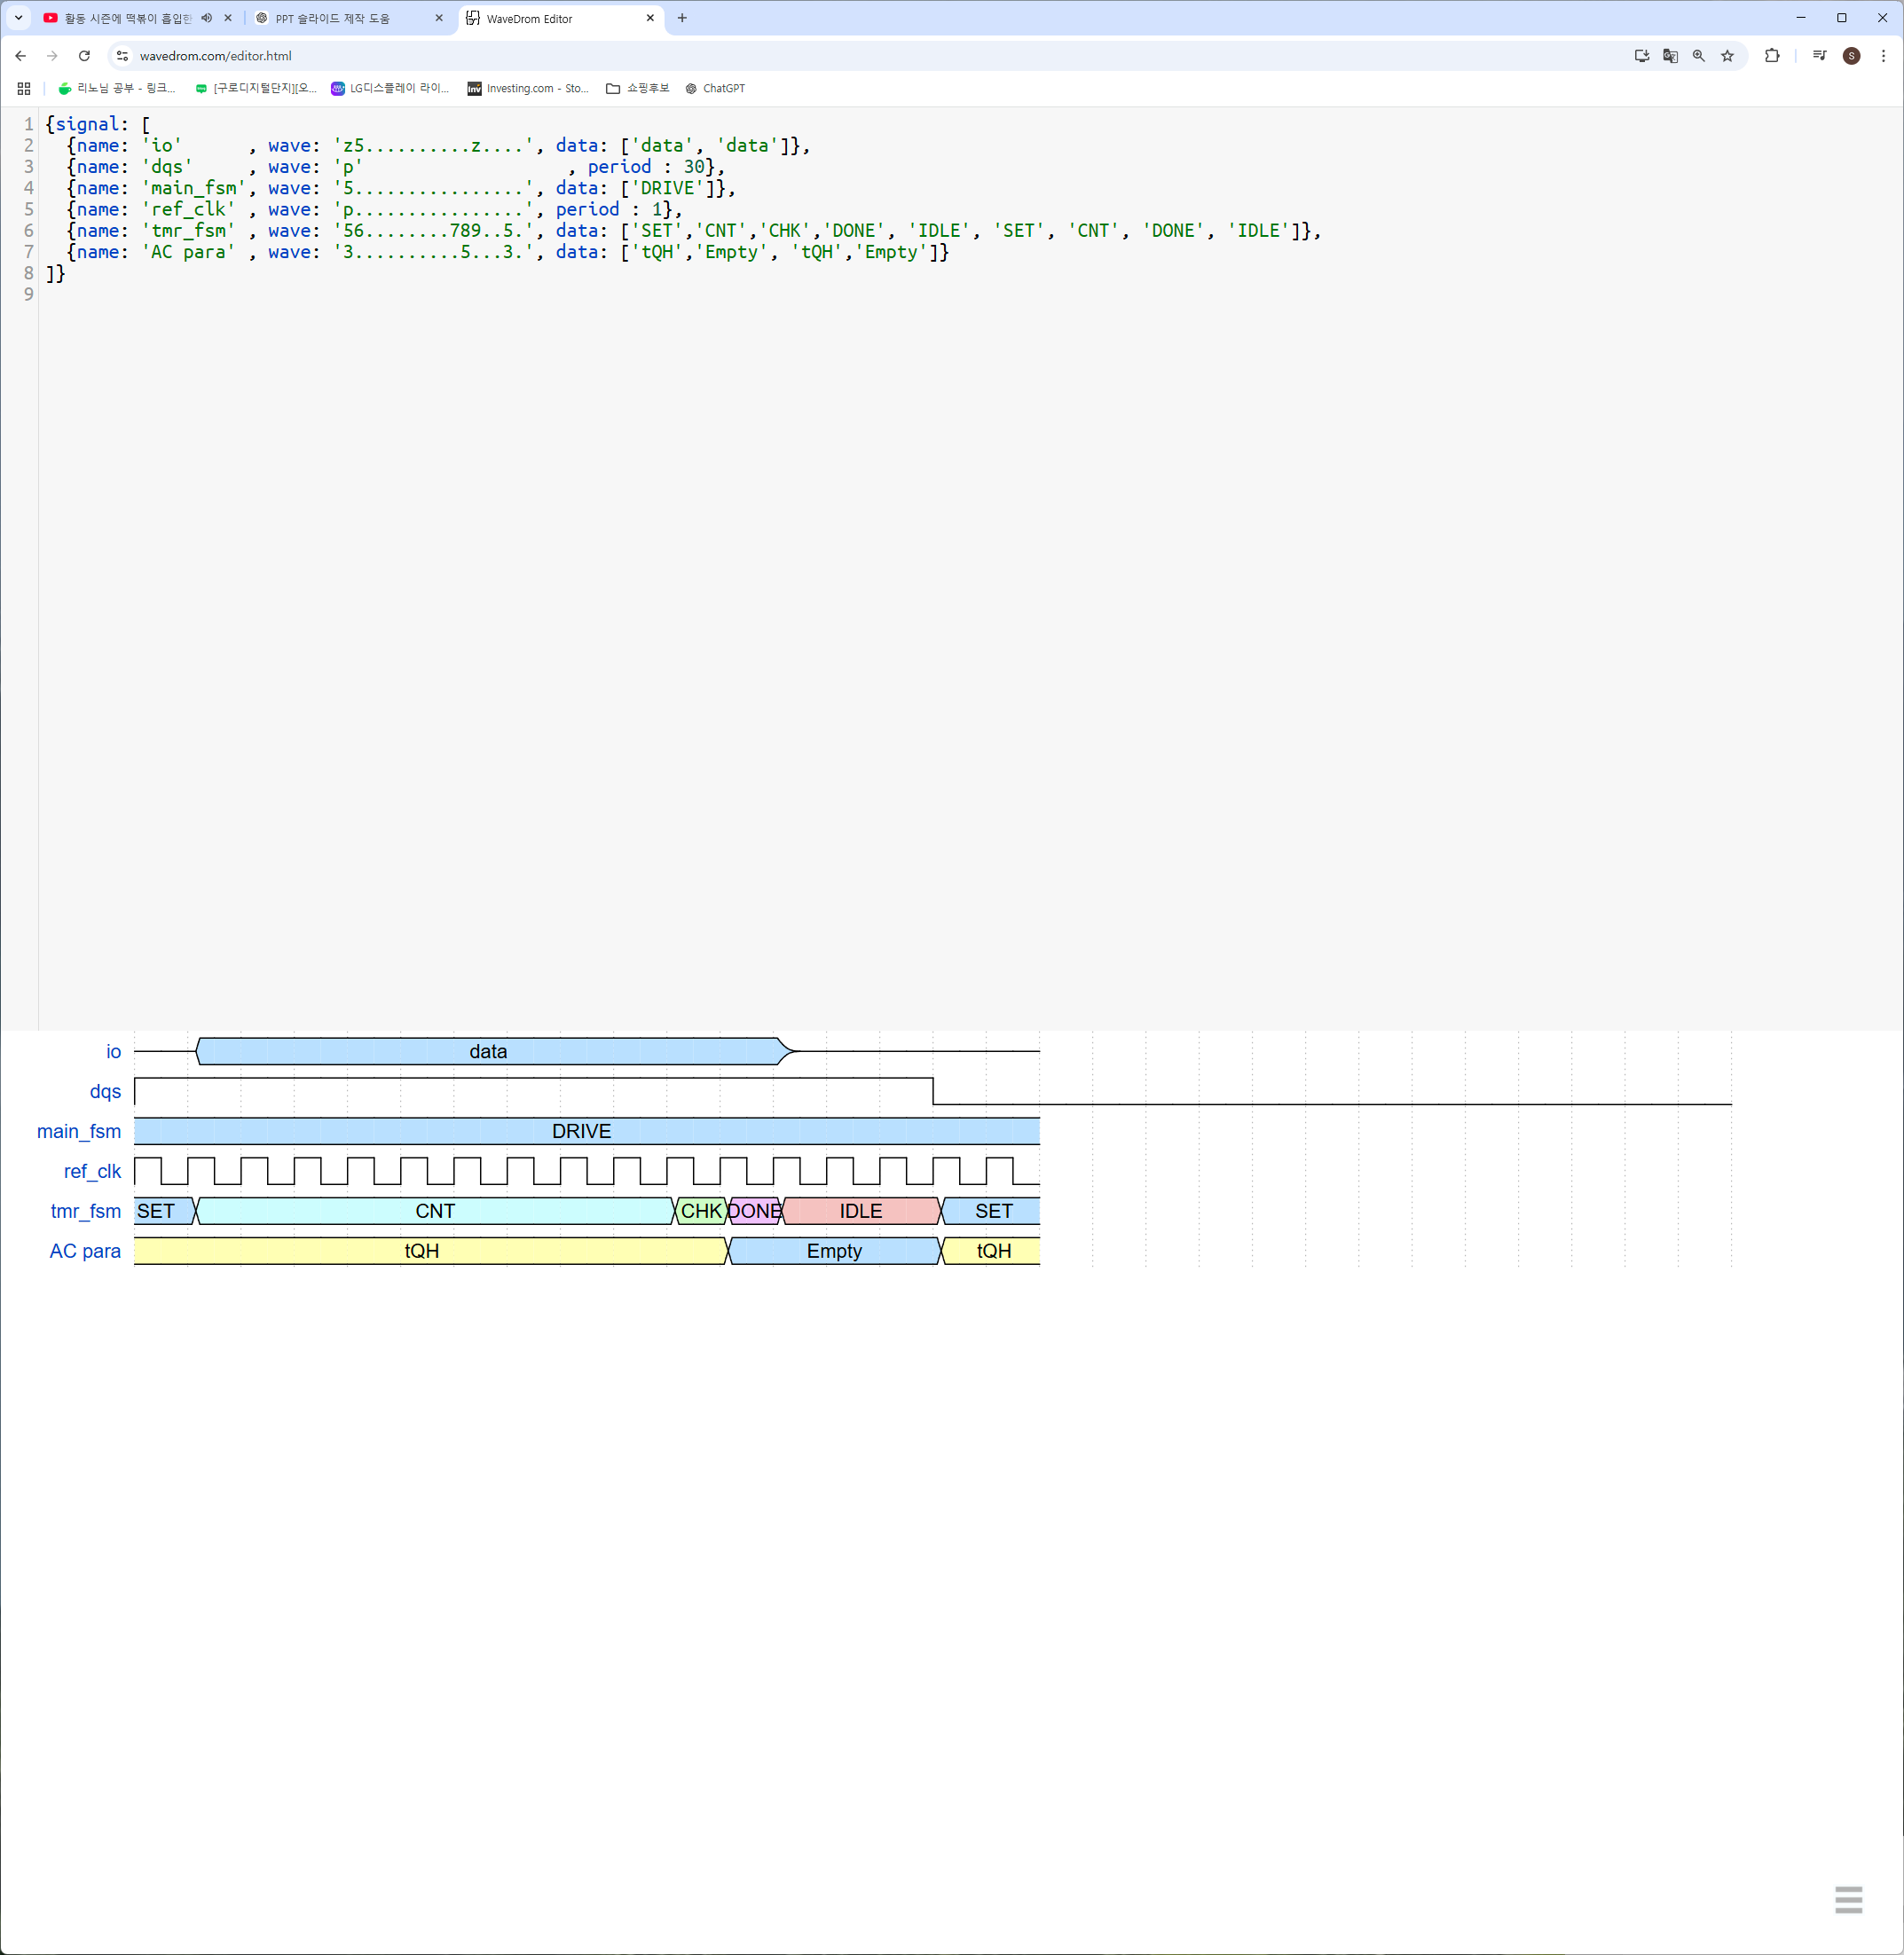
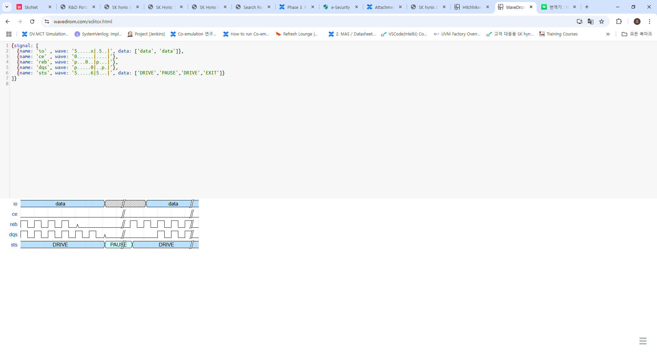
Main Operation Example – DRIVE State
HDL interface
HVL driver
Drive NAND signals
Activate the AC timer for
valid IO window
Nothing to do
Notes:
In the driver state, the main logic sends read data to the DUT and starts the AC Timer to create valid IO windows.
The diagram shows this process.
When dqs is triggered, the AC Timer is activated and sets a tQH time as the target.
Then, the timer waits for the tQH duration.
The process repeats every time dqs toggles.

Slide 24
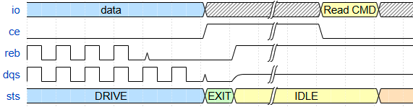
Main Operation Example – EXIT State
HDL interface
HVL driver
Complete the main OP FSM
Transit to IDLE state
Wait for the main OP FSM to finish
Wait for next command
Notes:
In the EXIT state, the main OP FSM in the HDL stops.
Once the HVL confirms this, it waits for the next NAND command

Slide 25
Experimental Results
Component | Description
Design Under Test | PCIe 4.0 SSD controller SoC
Emulator | Veloce StratoM
SW version - Emulator OS | Veloce v23.0.2
Simulator Version | Questa 2023.3
Host Interface | VirtuaLab PCIe 1.9.0
NAND device topology | 4 Channels, 4 Chip Enables, 2 Logical Units
Notes:
The table shows the experimental setup.
We tested a PCIe 4.0 SSD controller SoC as the DUT and used the Veloce StratoM as the emulator.
In addition, we used Siemens's host solution for PCIe stimulus.

Slide 26
Experimental Results
27x improvement compared to conventional NAND VIP
67% of the actual NAND's performance
67%
65%
x27
x36
Notes:
The left graph illustrates performance in terms of simulation time, while the right graph focuses on performance relative to data transfer.
Based on simulation time, our model achieved a 27× performance improvement compared to the previous model and 67% of a real NAND performance.
In terms of data transfer, it showed a 36× performance improvement over the previous model and 65% of a real NAND performance.
Although our proposed model is slightly slower than a real NAND, it remains highly competitive considering a variety of features it provides.

Slide 27
Conclusion
Re-modeling strategy
  Reducing communication frequency
    Move main operations from the HVL driver to the HDL interface
    Re-design synthesizable logic based on the FSM
  Re-modeling AC Timing using the AC Timer logic and the shift Registers
Advantages of our model
  27x faster than the conventional model and 67% of the real NAND
  Efficiently cover unclear features of next-generation NAND
Notes:
In this presentation, we propose a modeling technique optimized for emulators.
Our approach focuses on two key aspects.
First, we aim to reduce communication between the HDL and the HVL by moving key HVL driver operations to the HDL interface and redesigning them as synthesizable logic.
Second, we optimize timing by redesigning the AC Timer and shift registers to improve performance.
With our model, verification is about 30 times faster than the previous model and it also efficiently manages unclear features.

Slide 28
Questions
Thanks for attending!
Any questions?
Notes:
.

