Slide 1
A Case Study on LMS Filter Datapath Verification Using Generative AI and MATLAB DPIGEN
Kuan-Ting Chen

Slide 2
Agenda
Challenges in DSP Datapath Verification
Cycle-Accurate LMS Filter Datapath Verification Demonstration
Generative AI
MATLAB Function
MATLAB Testbench
RTL
SystemVerilog Assertions
Test Stimulus
Waveform Results
Conclusion

Slide 3
Challenges in DSP Verification Techniques
Digital Signal Processing (DSP) algorithms typically developed in MATLAB
RTL and verification implemented in SystemVerilog
Verification gap exists due to different languages used
Conventional verification techniques
Golden test vectors comparison
Limited scalability and design state spaces coverage
Checkers manually created by verification engineer
Iterative revisions

Slide 4
DPIGEN Based Verification
Directly reuse MATLAB algorithm as golden reference model
Mathwork dpigen() automatically generates SystemVerilog DPI-C verification components from MATLAB function
Enable constraint randomized stimulus for bug hunting
In practice, debugging is difficult in DPI-based datapath verification
Intermediate results or internal variables are not accessible
Proposed Solution
SystemVerilog assertions can improve debuggability
Generative AI can write such SVA based on the specification

Slide 5
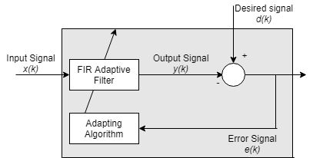
Least Mean Squares (LMS) Adaptive Filter
A filter which adjusts its filter coefficients to minimize the mean square error between output signal (Y) and desired signal (D)
$MSE=\frac{1}{n}\sum_{k=0}^{n}{{\left(Y_{k}−D_{k}\right)}^{2}}$
Application in unknown system identification, noise cancellation, channel equalization

Slide 6
MATLAB Function Generation
Please give me one Least Mean Square adaptive filter MATLAB function named “lms_filter_one_cycle” which calculates only one clock cycle. The datapath signals should be quantized by M bits using built-in function floor as truncation.

Slide 7
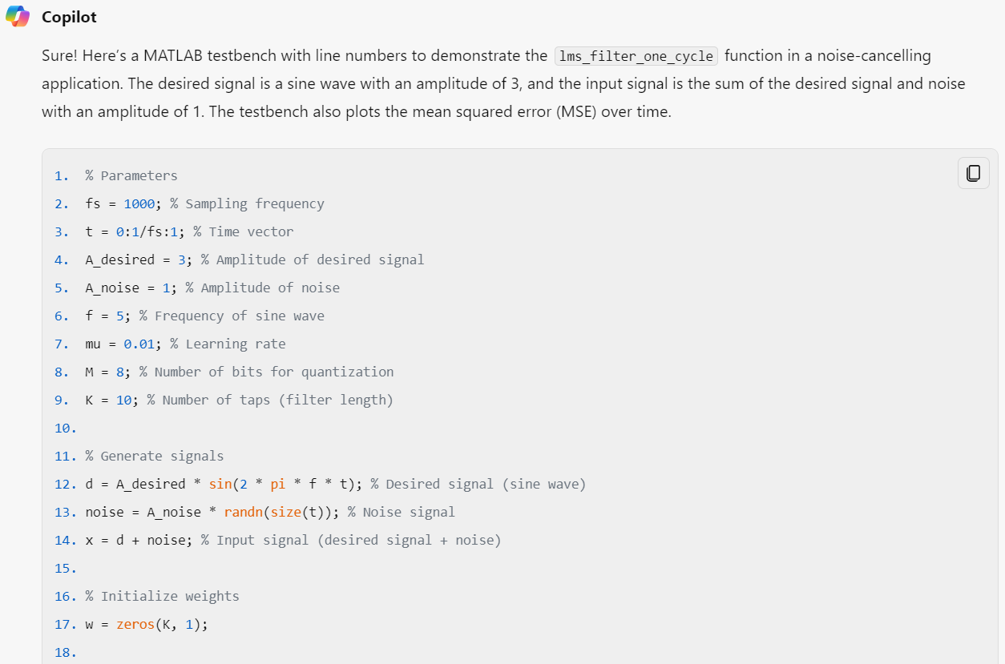
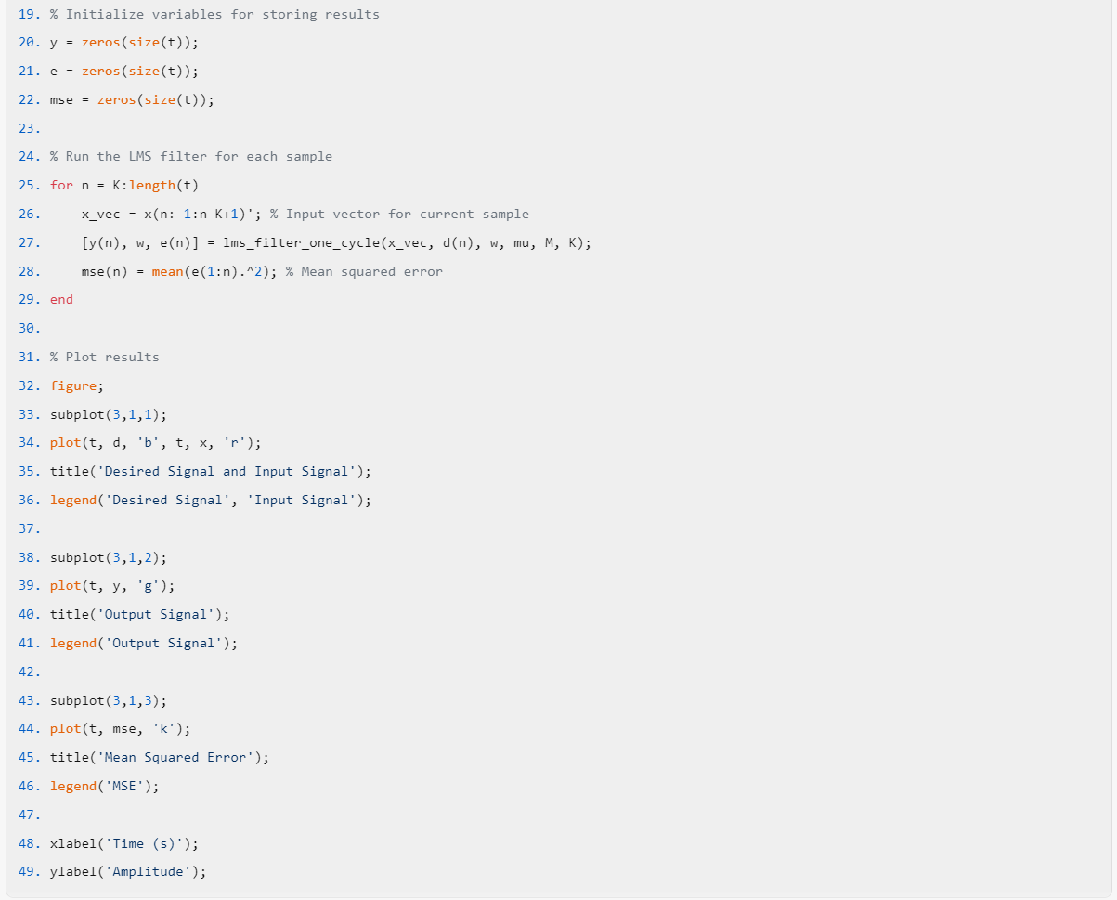
MATLAB Testbench Generation
Please give me a MATLAB testbench to demonstrate the generated function "lms_filter_one_cycle" in noise cancelling application. The desired signal is a sine wave with amplitude of 3 and input signal is the addition of the desired signal and a noise with amplitude of 1. Also plot the mean squared error over time

Slide 8
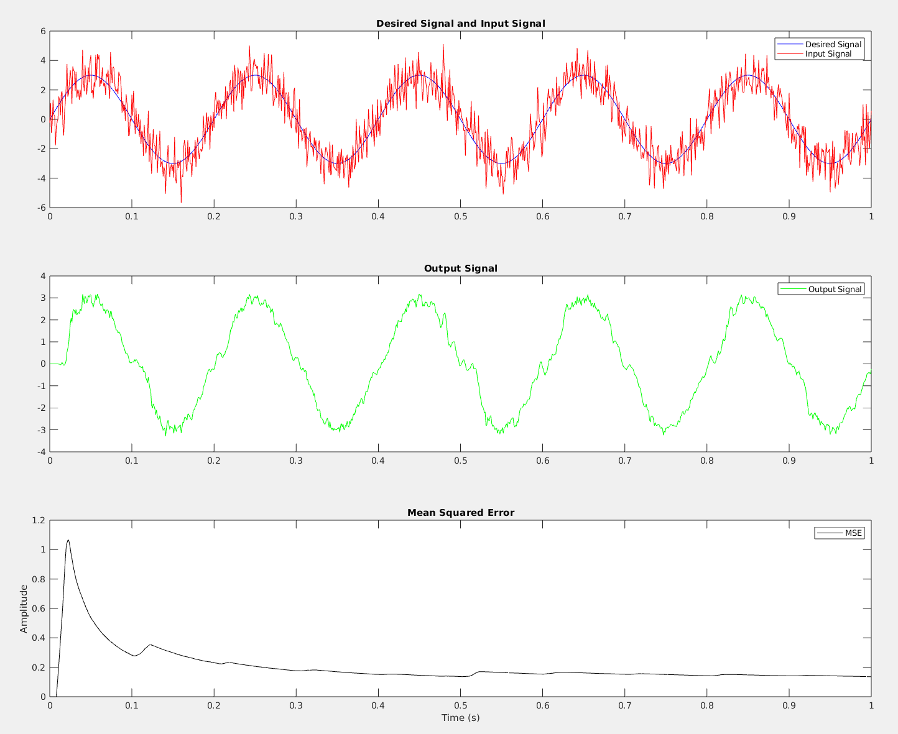
Validation of Generated LMS Algorithm
Mean Squared Error (MSE) shows a consistent reduction over time

Slide 9
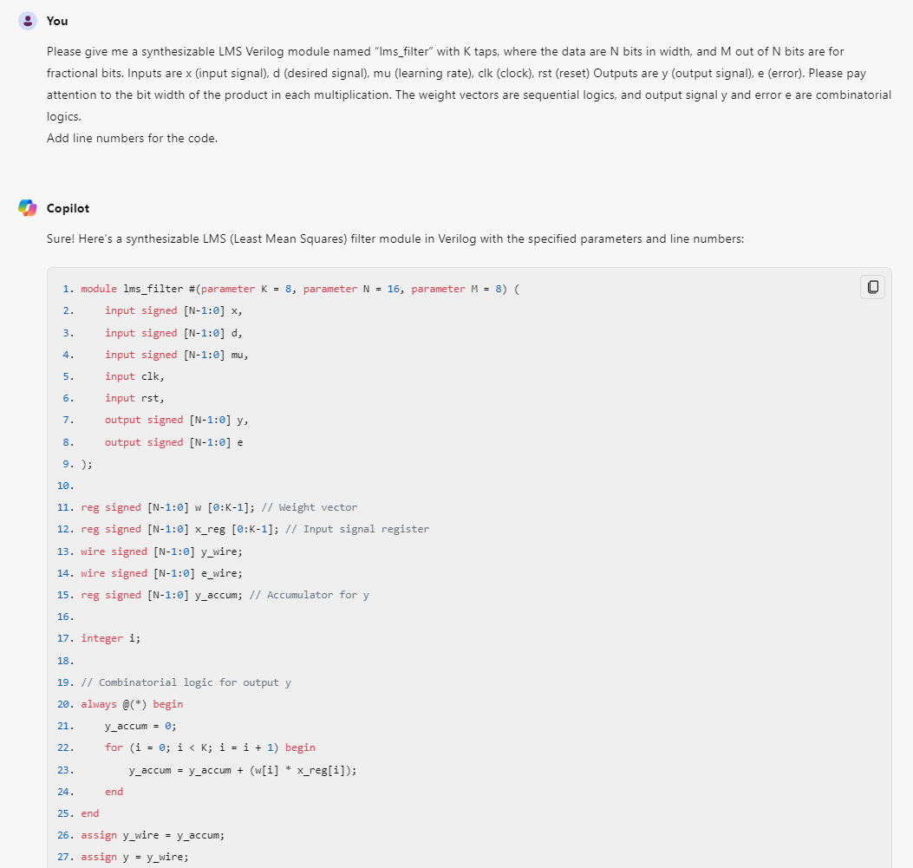
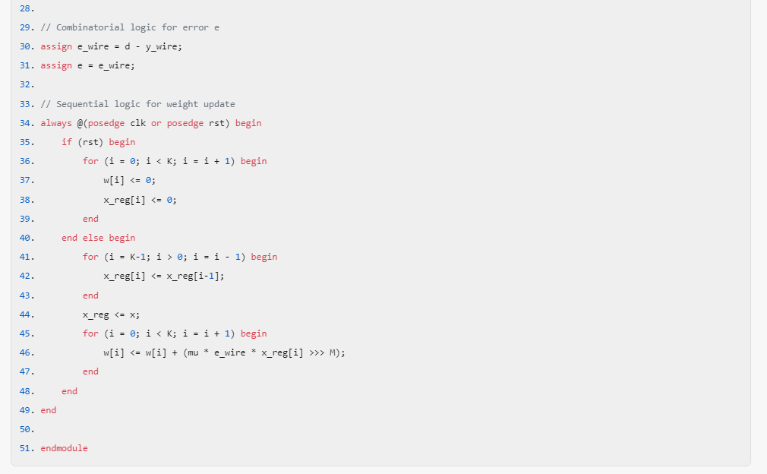
LMS Filter RTL Generation
Please give me a synthesizable LMS Verilog module named “lms_filter” with K taps, where the data are N bits in width, and M out of N bits are for fractional bits. Inputs are x (input signal), d (desired signal), mu (learning rate), clk (clock), rst (reset) Outputs are y (output signal), e (error). Please pay attention to the bit width of the product in each multiplication. The weight vectors are sequential logics, and output signal y and error e are combinatorial logics

Slide 10
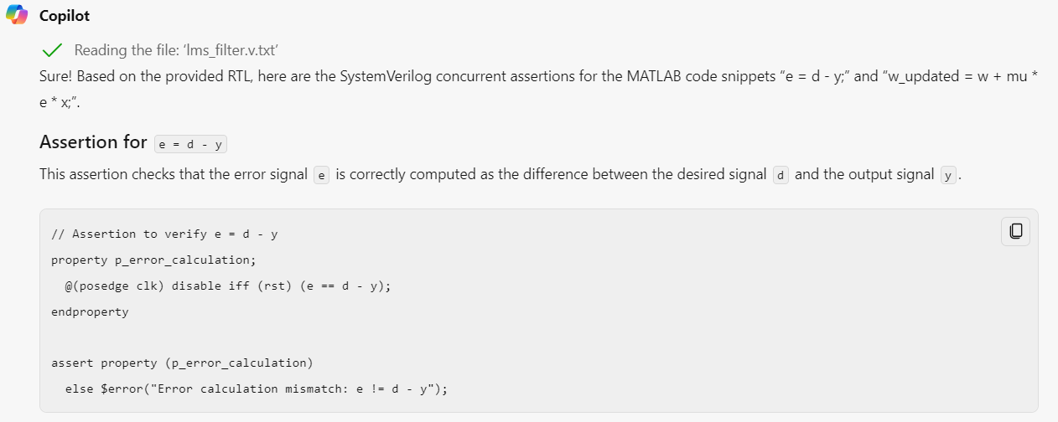
SVA Generation for Error Signal Calculation
Can you write SystemVerilog concurrent assertions based on MATLAB code "e = d - y;" and "w_updated = w + mu * e * x";?

Slide 11
SVA Generation for Weight Update Logic
Can you write SystemVerilog concurrent assertions based on MATLAB code "e = d - y;" and "w_updated = w + mu * e * x";?

Slide 12
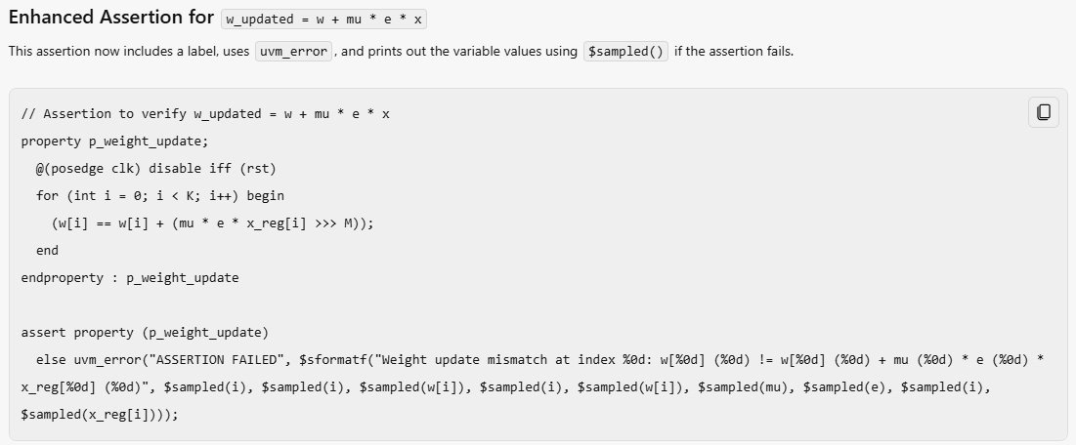
SVA Coding Style Enhancement Prompt
Please do some enhancements including, 1. Use labels for assert statements 2. Use `uvm_error instead of $error 3. Use endproperty with end label 4. Print out variables value if assertion fail and use $sampled() in value prints in action block
Now coding style is good, but functional issues persists

Slide 13
Question Copilot About Using for loop in SVA
Copilot knew the answer with a good explanation, but failed to generate the correct assertion sequence

Slide 14
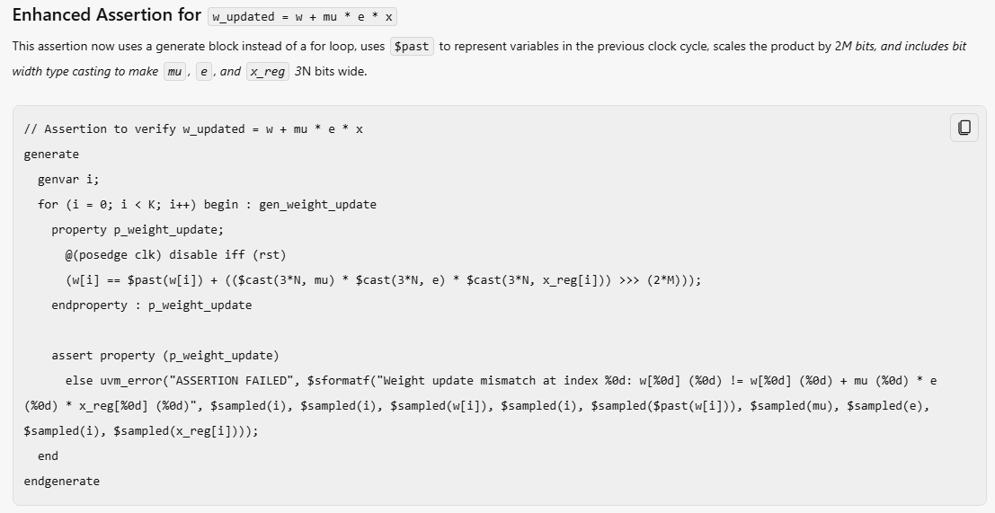
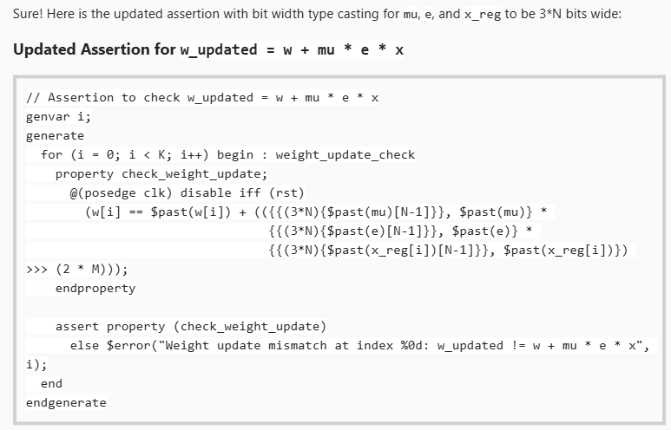
SVA Correction Prompt
In the second assertion, use generate instead of for loop. Use $past to represent variables in previous clock cycle. The product should be scaled by 2*M bits. Also please do bit width type casting to mu, e, x_reg to be 3*N bit wide.

Slide 15
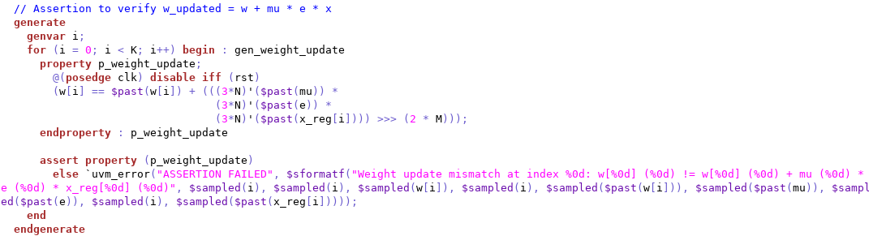
Revised SVA by Human
Human intervention is still required to correct the generated SVA
Human correction on bit width casting

Slide 16
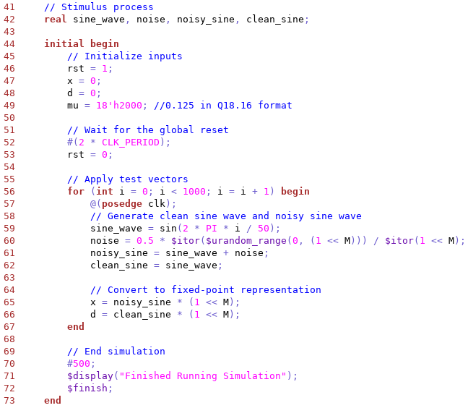
Stimulus Generation

Slide 17
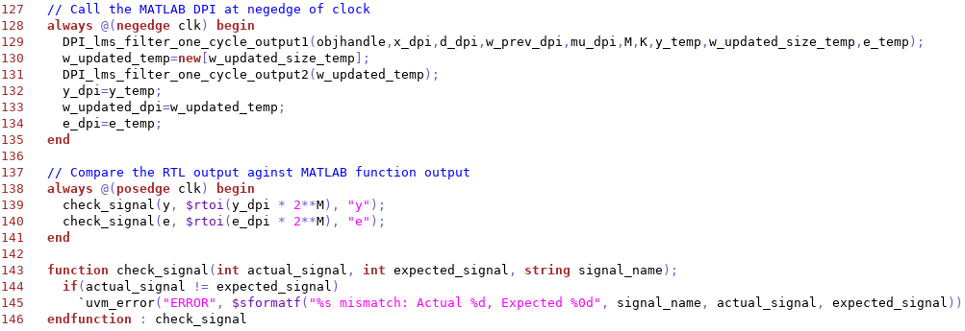
DPI-C Cycle Accurate Predictor

Slide 18
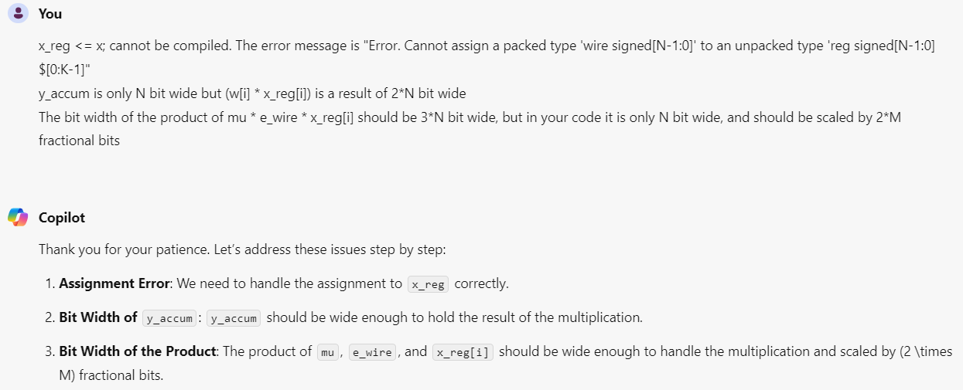
Identified Bugs in Generated RTL
(Syntax Bug)
(Multiplication & Precision Bug)
(Multiplication Bug)
Variables are N bits wide, with M bits representing fractional numbers
Mixed blocking and non-blocking assignment

Slide 19
Cycle-Accurate Waveform (Noise Cancellation)
Desired Signal
RTL Input Signal
DPI Input Signal
RTL Output Signal
DPI Output Signal
RTL Output Signal
Scaled DPI Output Signal

Slide 20
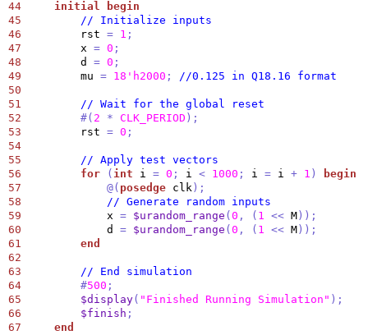
Cycle-Accurate Waveform (Random)
Desired Signal
RTL Input Signal
DPI Input Signal
RTL Output Signal
DPI Output Signal
RTL Output Signal
Scaled DPI Output Signal

Slide 21
Conclusion
Adding SVA can address black box limitation in DPI debuggability
Access intermediate results
Pinpoint causes of RTL-DPI mismatches easily
Generative AI can assist in DSP datapath design and verification
Generate MATLAB algorithm code in good quality
Efficient simple stimulus generation
Ability to read the specification and provide a solid framework for basic RTL and SVA development
For complex assertions, careful reviews and modifications are still required
Detailed and well-crafted prompts achieve optimal results

Slide 22
Questions?

